Slide 1
Building apps for Microsoft SharePoint and OneDrive
Integrate and extend with your application experience
Version 1.1

Slide 2

Agenda
Microsoft SharePoint and OneDrive overview and opportunity
Extensibility scenarios
Files
Lists
SharePoint Framework (SPFx)
Deployment and configuration
Open source

Slide 3
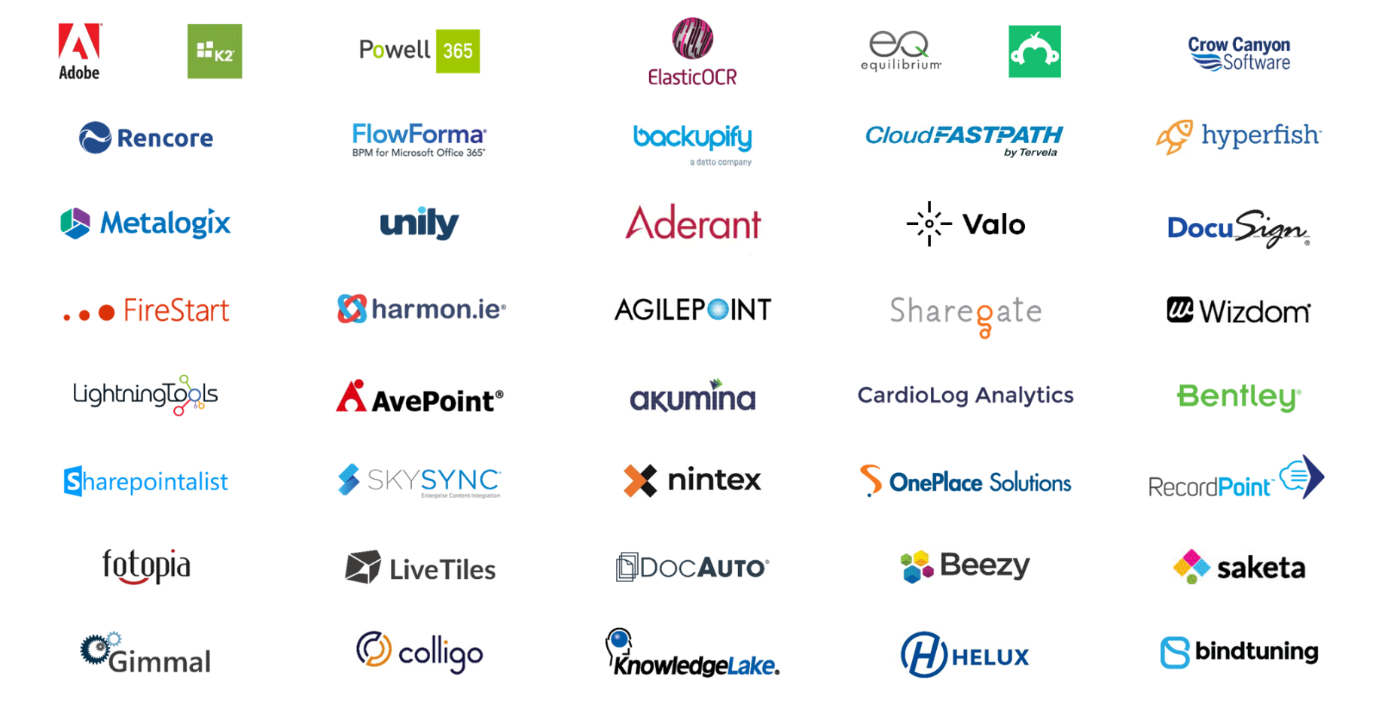
Partners building with SharePoint and OneDrive

Slide 4








SharePoint and OneDrive
OneDrive
Team sites
Intranet sites portals
Portals & Lists integration Power Apps & Power Automate
Share and work together
Inform and engage people
Harness collective knowledge
Transform business processes
Extend & develop

Slide 5



Microsoft 365 extensibility foundation
Office apps
Create & co-author documents
SharePoint
Pages & content management
Azure AD & Office 365 Groups
Identity & membership
Outlook
Email & calendar
Teams
Hub for teamwork
Microsoft Graph
Data & intelligence
Microsoft 365 Trust
Security & compliance
OneDrive
All your files, anywhere
Automation
Integrated processes
Windows 10
Rich user experience

Slide 6
SharePoint & OneDrive functional design
3rd Party web extensibility
SharePoint Framework (SPFx) \ File handlers
1st party apps
OneDrive \ Teams \ Office \ etc.
3rd party apps
DLP \ Search \ Files \ Lists \ Photos
Data bound controls
Web templating
SharePoint home, team sites, comm sites, ODB, etc.
OneDrive
consumer
API Surface (Graph \ REST \ CSOM)
Graph \ REST
Tenant\site collection abstraction
User abst
Files CRUD
+ services
Lists CRUD
+ services
Web pages CRUD
+ services
Files CRUD
+ services

Slide 7
Files extensibility scenarios
An overview of the extensibility options when working with files in SharePoint and OneDrive

Slide 8
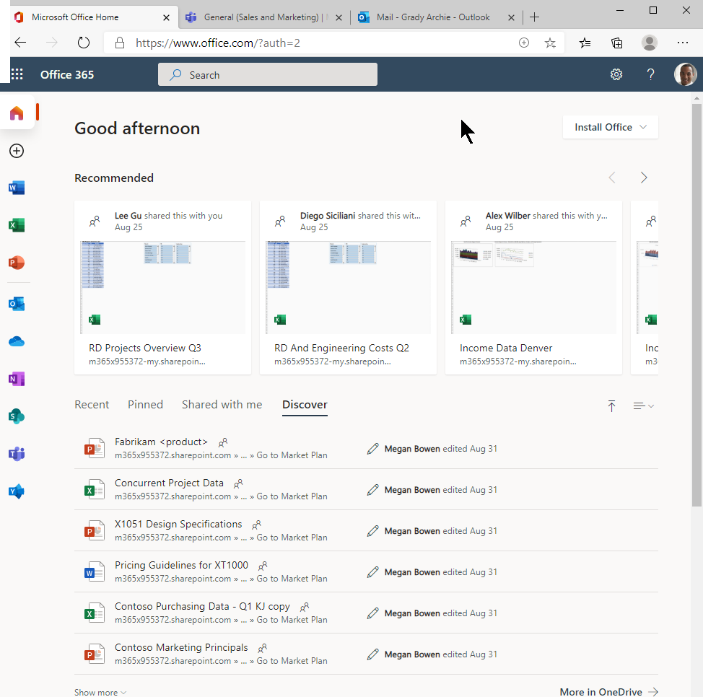
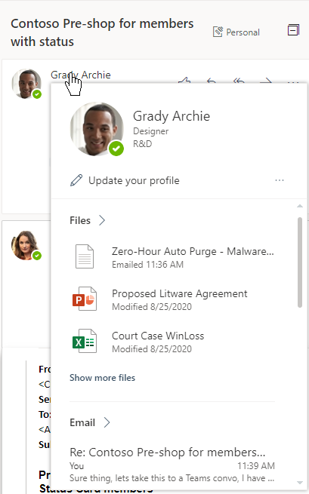
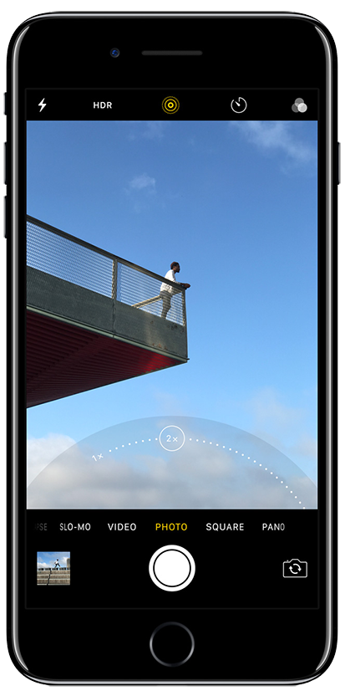
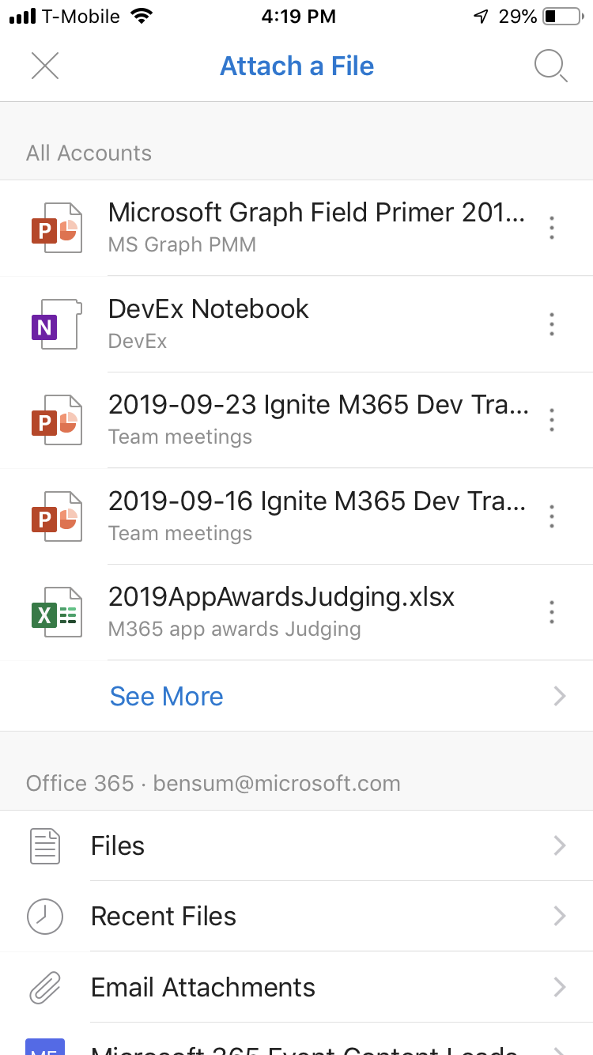
Files
File preview
No additional infrastructure for hosting
Maintain a focus on your app while we do the rest
Government and industry compliant

Slide 9




Improved turbocharged SharePoint file storage
10X
3X
30x
320+
faster downloads
performance
faster indexing
file types
AI-powered insights
Intelligent security
Innovative experiences

Slide 10


Viewing, selecting and uploading files
Deep integration via API’s
Owning my file types

Slide 11
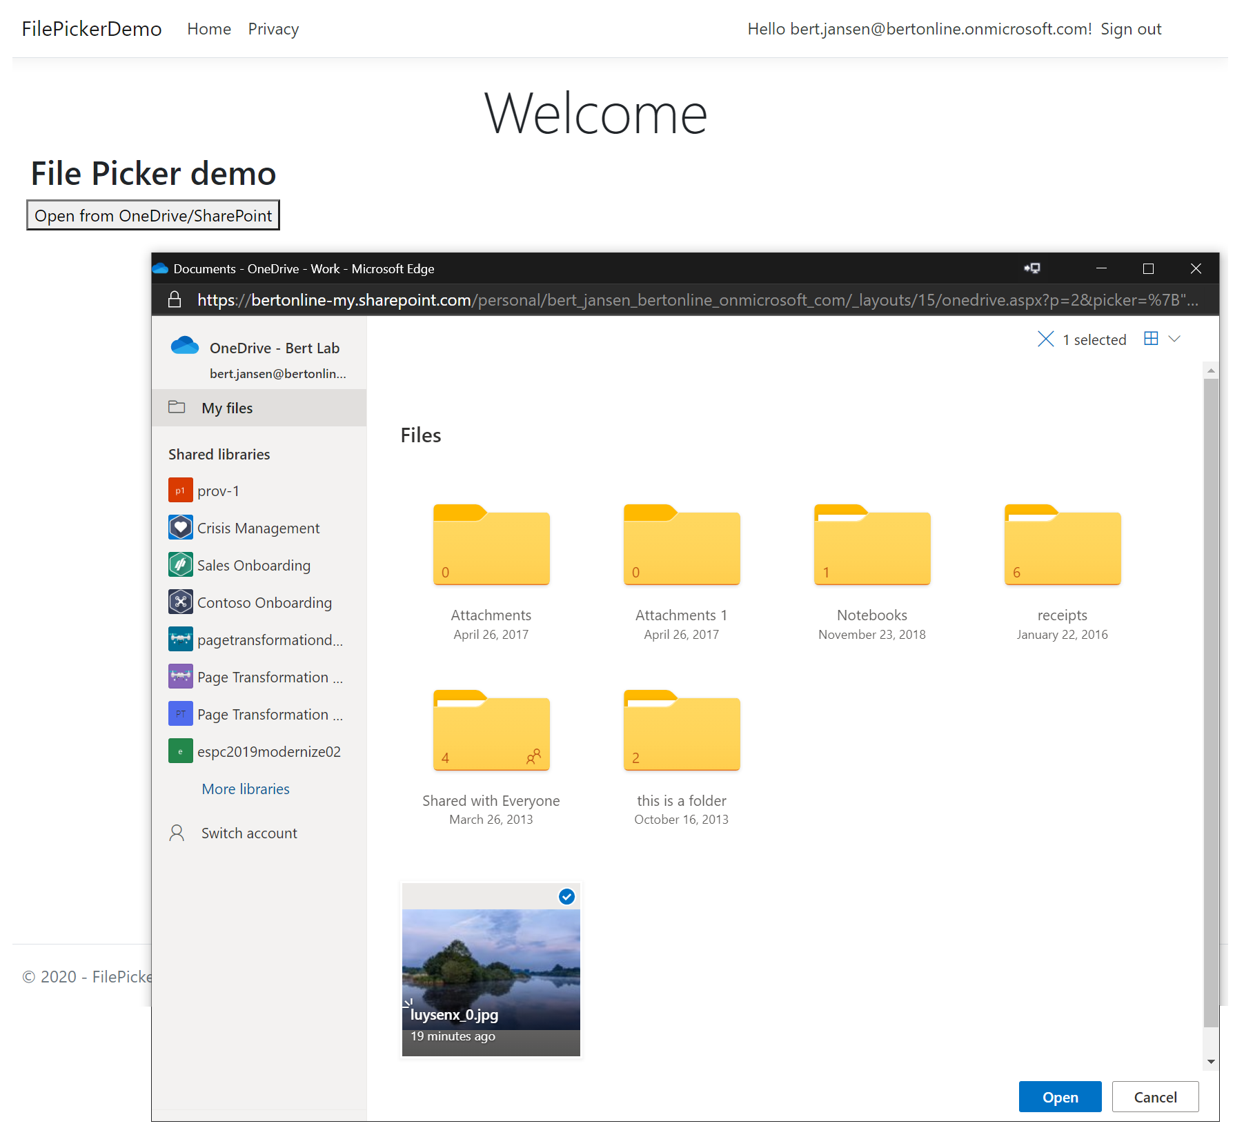

Selecting files
Control allowing file browsing and picking
File Open mode: allows for file downloads via direct download link, file id’s (for API access) or read-only sharing link
Implementation
JavaScript library: https://js.live.net/v7.2/OneDrive.js
Resources
Opening files documentation
SPFX sample
A new picker experience is in progress

Slide 12
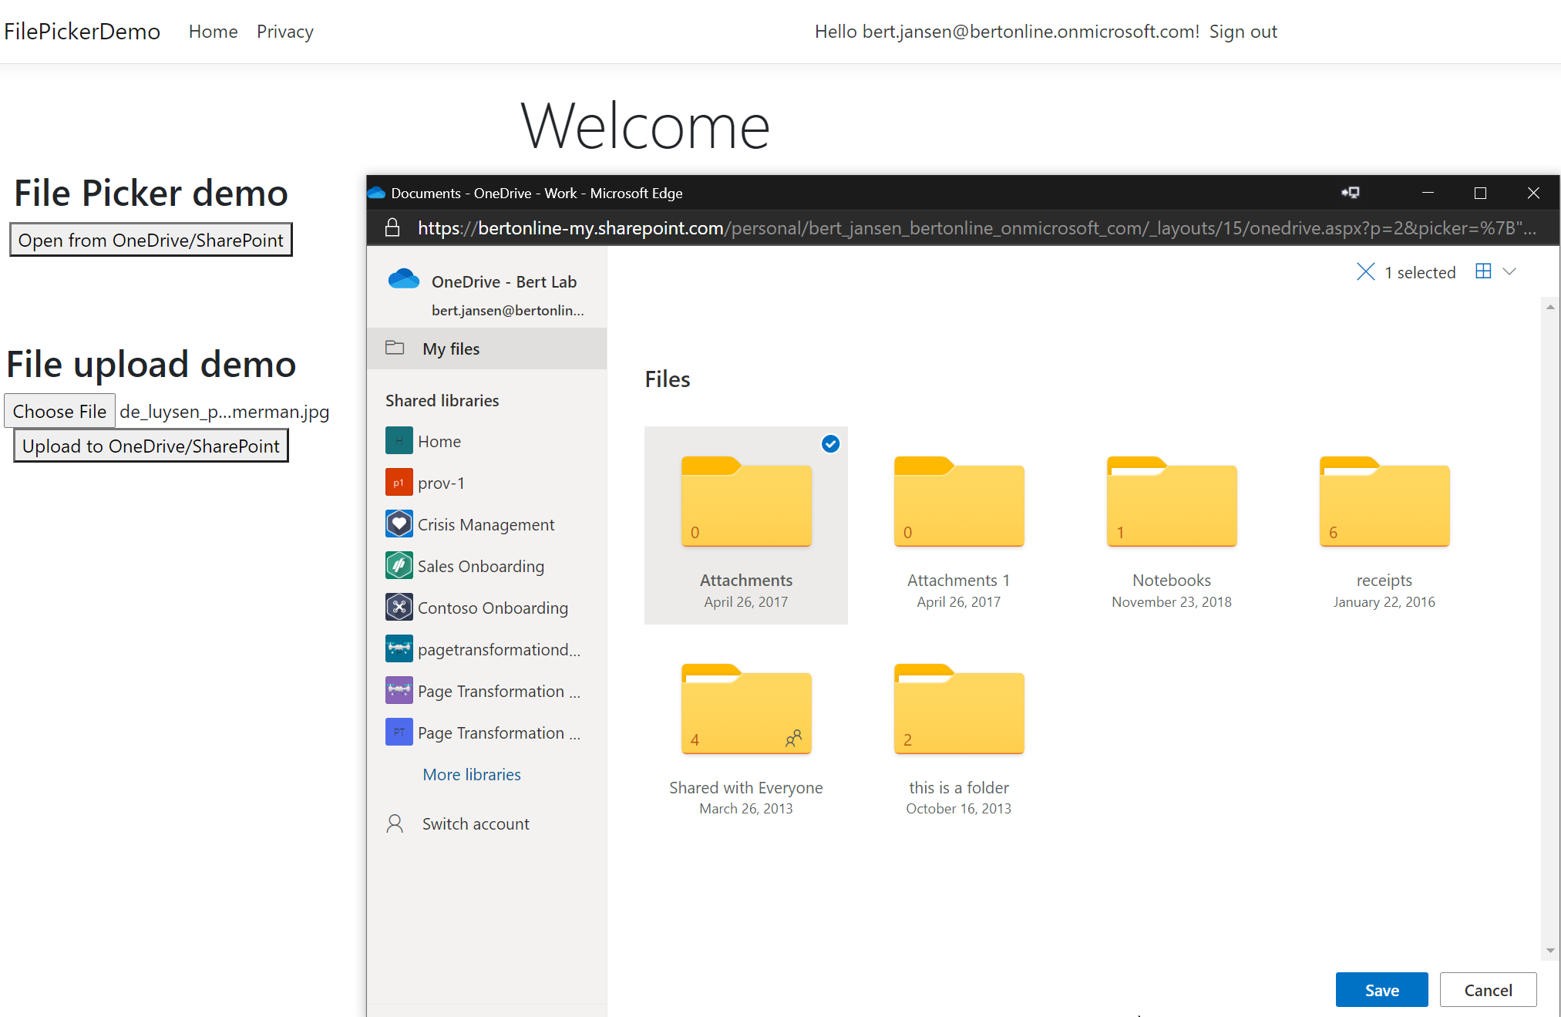
Uploading files
Control allowing file browsing and uploading
File Save mode: file upload via direct upload or upload location id’s (for API access)
Implementation:
JavaScript library: https://js.live.net/v7.2/OneDrive.js
Resources
Saving files documentation
A new picker experience is in progress

Slide 13
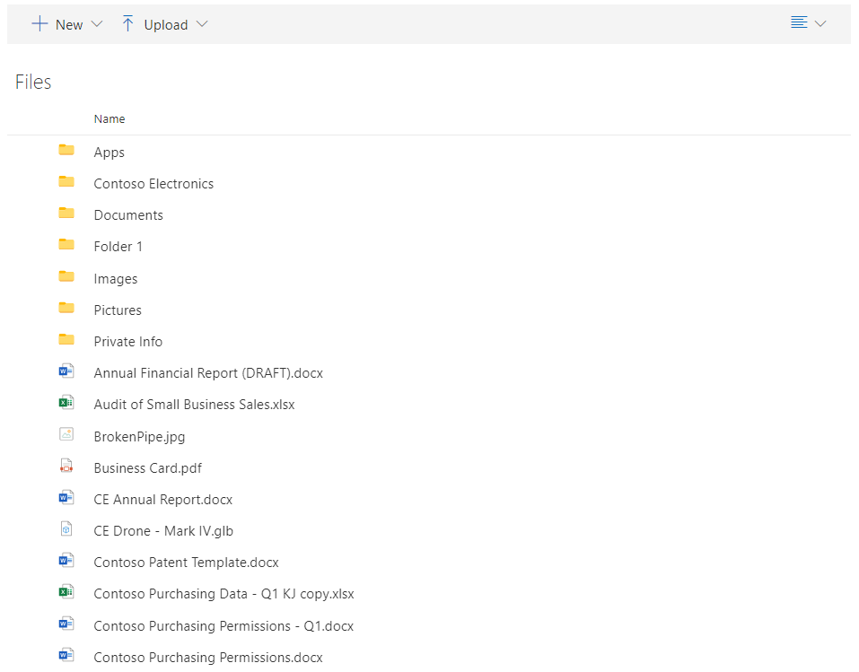
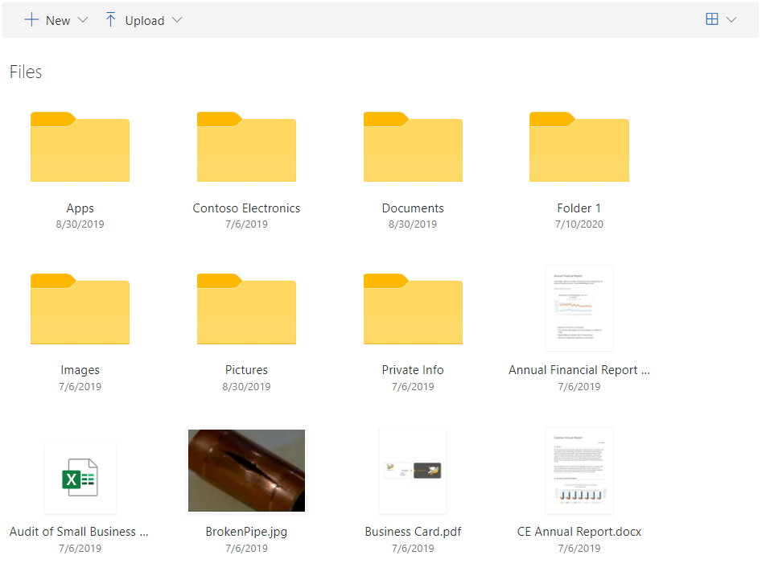
Browsing files
Embed a browsing control in your application that works similar as the browsing files in Microsoft’s products like Office, SharePoint and Teams
Coming to preview soon!

Slide 14

Viewing, selecting and uploading files
Deep integration via API’s
Owning my file types

Slide 15
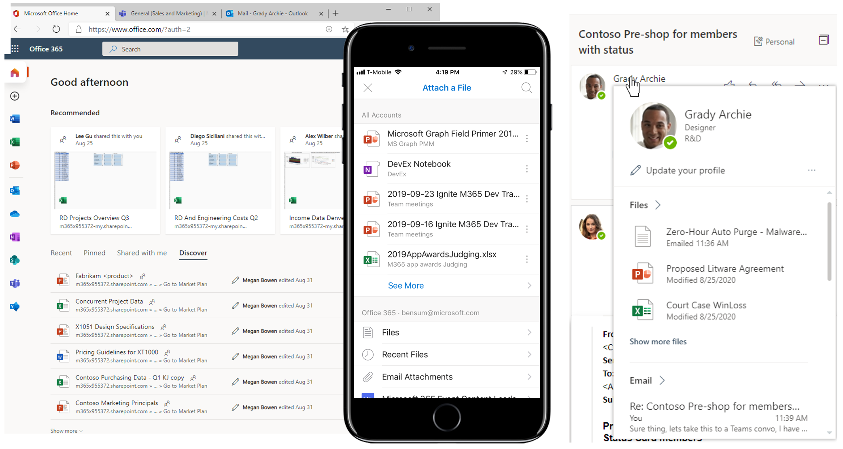

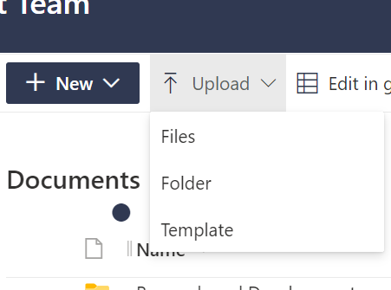
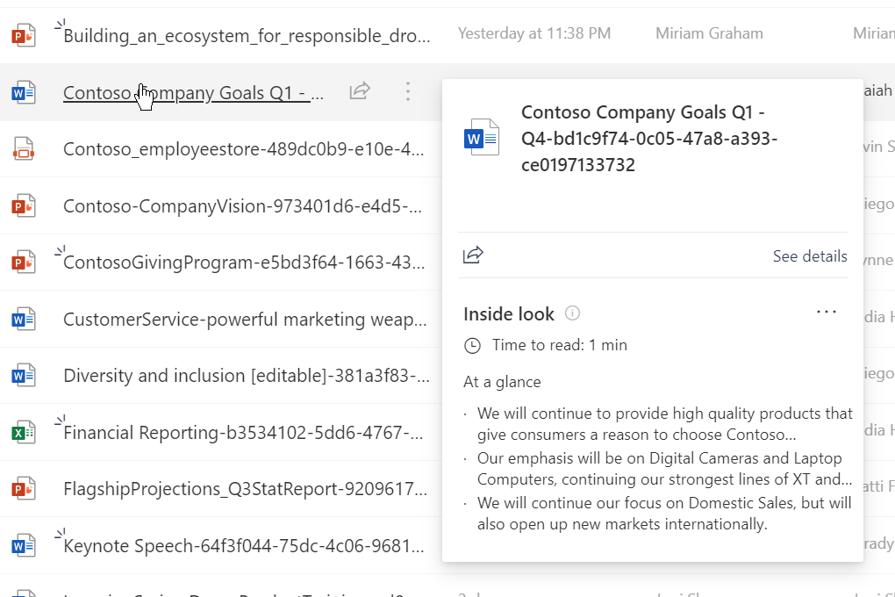

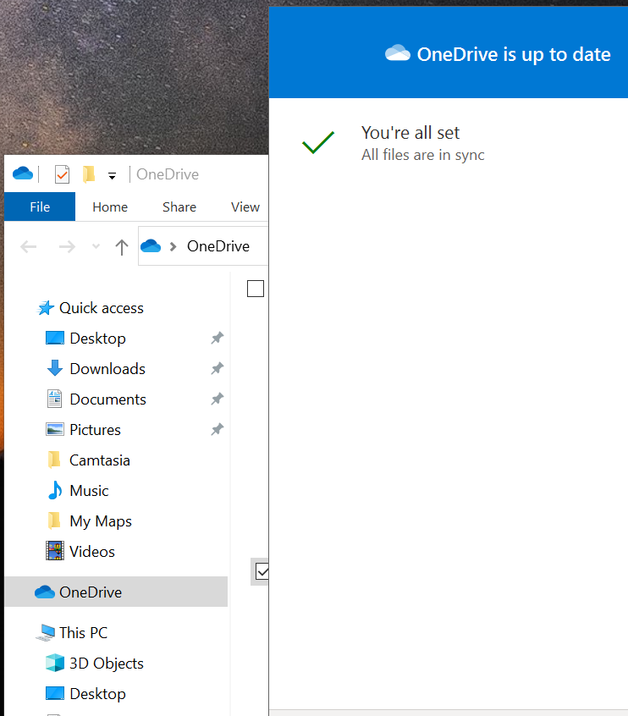
Single source for personal and corporate data
Files (drive/drive item) represents an item within a drive, like a document, photo, video, or folder
/v1.0/me/drive
/v1.0/sites/{id}/drives
/V1.0/sites/{id}/drive/items/{id}
/v1.0/groups/{id}/drive
Microsoft Graph
Use in a file picker
Native file viewing
Integrated search Exp.
Doc gen & save
Native file syncing

Slide 16
Basic Microsoft Graph elements
Sites – Contains lists, drives, and subsites
/v1.0/sites/{site-id}
Drive – Contains files and folders
DriveItem – A file or folder that is in a drive
/v1.0/sites/{siteId}/drive/items/{item-Id}

Slide 17

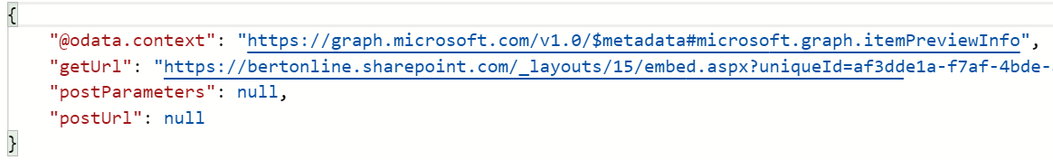
File previews
Graph API to get previews of 320+ file types
v1.0/me/drive/items/{id}/preview
v1.0/sites/root/drives/{drive-id}/items/{id}/preview
Resources
File documentation

Slide 18

File thumbnails
Graph API to get thumbnails of 320+ file types
v1.0/me/drive/items/{id}/thumbnails/0/large/content
v1.0/sites/root/drives/{driveid}/items/{id}/thumbnails/0/large/content
Resources
File thumbnails documentation

Slide 19
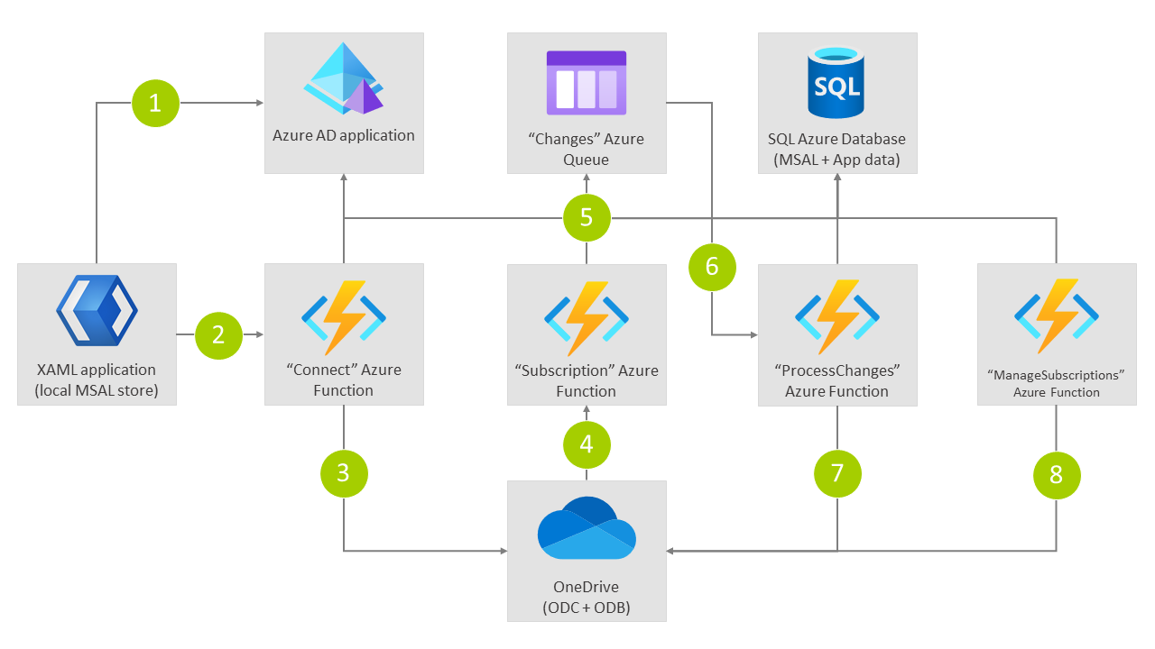
Subscriptions and delta queries
Microsoft Graph based web hooks that you can use to be notified of events
Delta queries to just get the changes since last time
Resources
Subscription's documentation
Delta query documentation
OneDrive files integration sample (.NET)

Slide 20
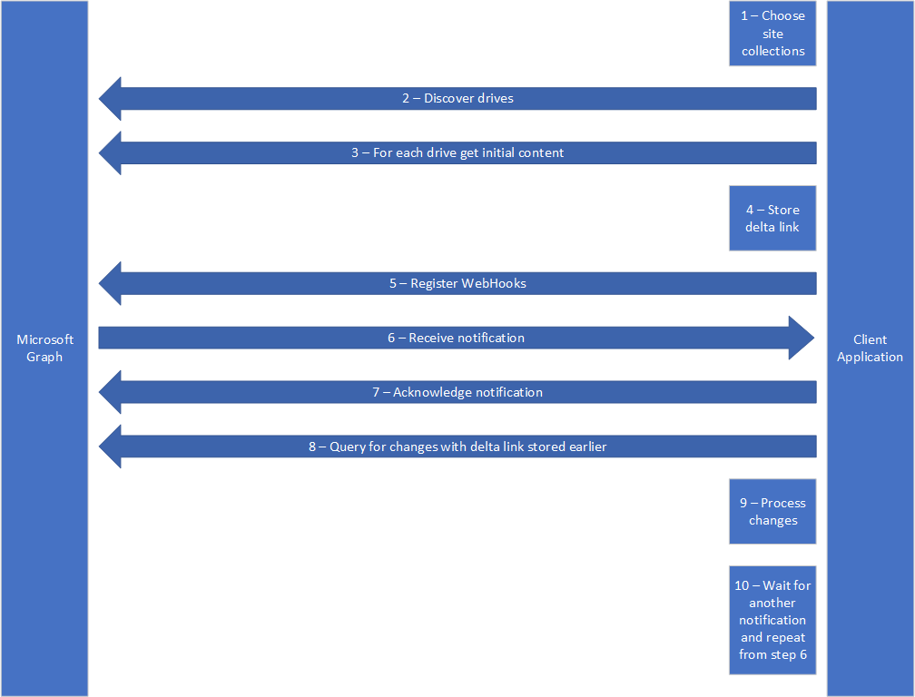
Scan guidance
Best practices for discovering files and detecting changes at scale
Continuously crawling all SharePoint content is not recommended, being notified of changes is a much better pattern
Resources
Scan guidance documentation
Delta query documentation

Slide 21

Viewing, selecting and uploading files
Deep integration via API’s
Owning my file types

Slide 22
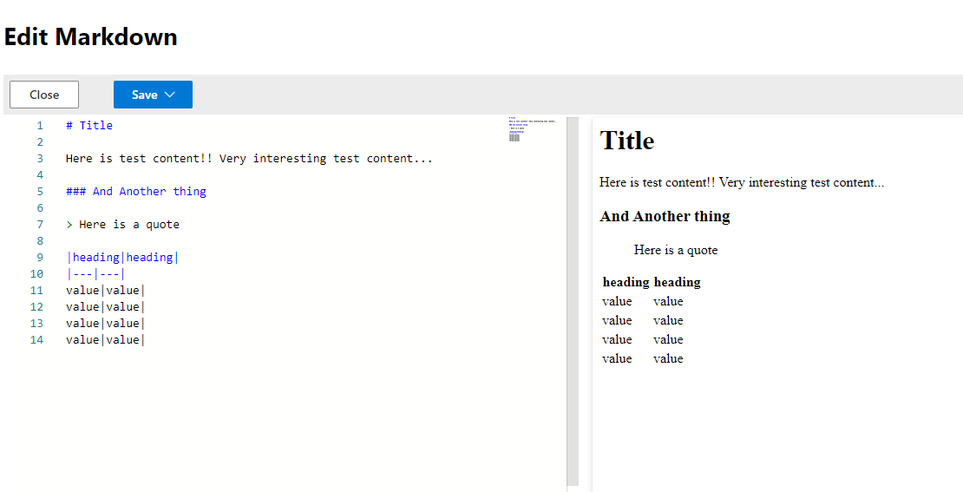
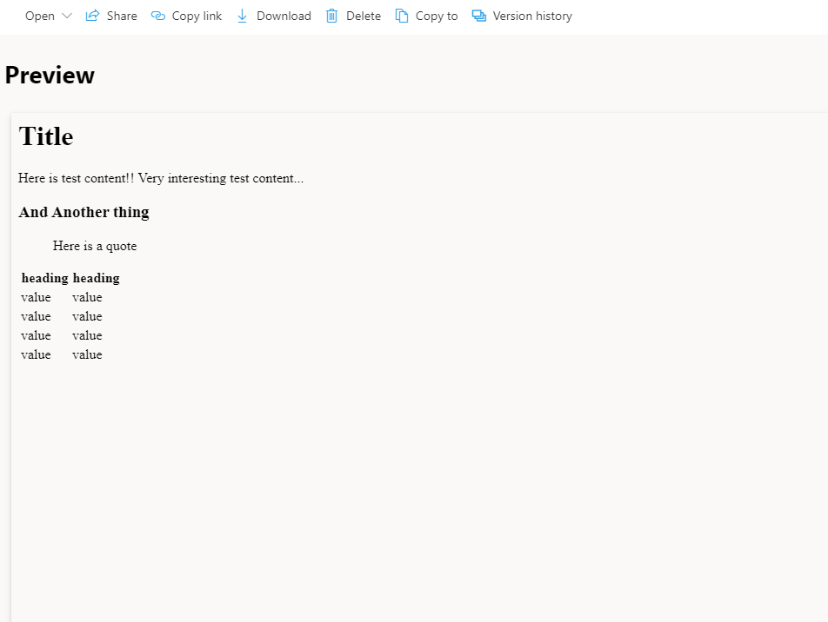
File handlers
Enabling custom file experiences for your file types
File preview
Create new files in the browser
Rich view/edit capability
Custom actions that launch into your app
Customized file icons
Resources
File handlers documentation
Markdown sample file handler

Slide 23
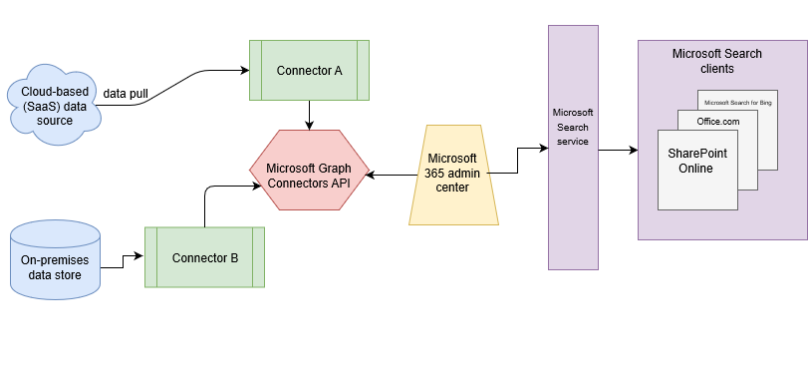
Graph connectors
Enables ISV/third party specific data to appear in Microsoft search results
Index your file data
9 Microsoft built connectors – 100+ 3rd party connectors
Resources
Graph connector documentation
Microsoft Graph connectors gallery
Graph connector dotnet sample

Slide 24
List extensibility scenarios
An overview of the extensibility options when working with lists in SharePoint

Slide 25
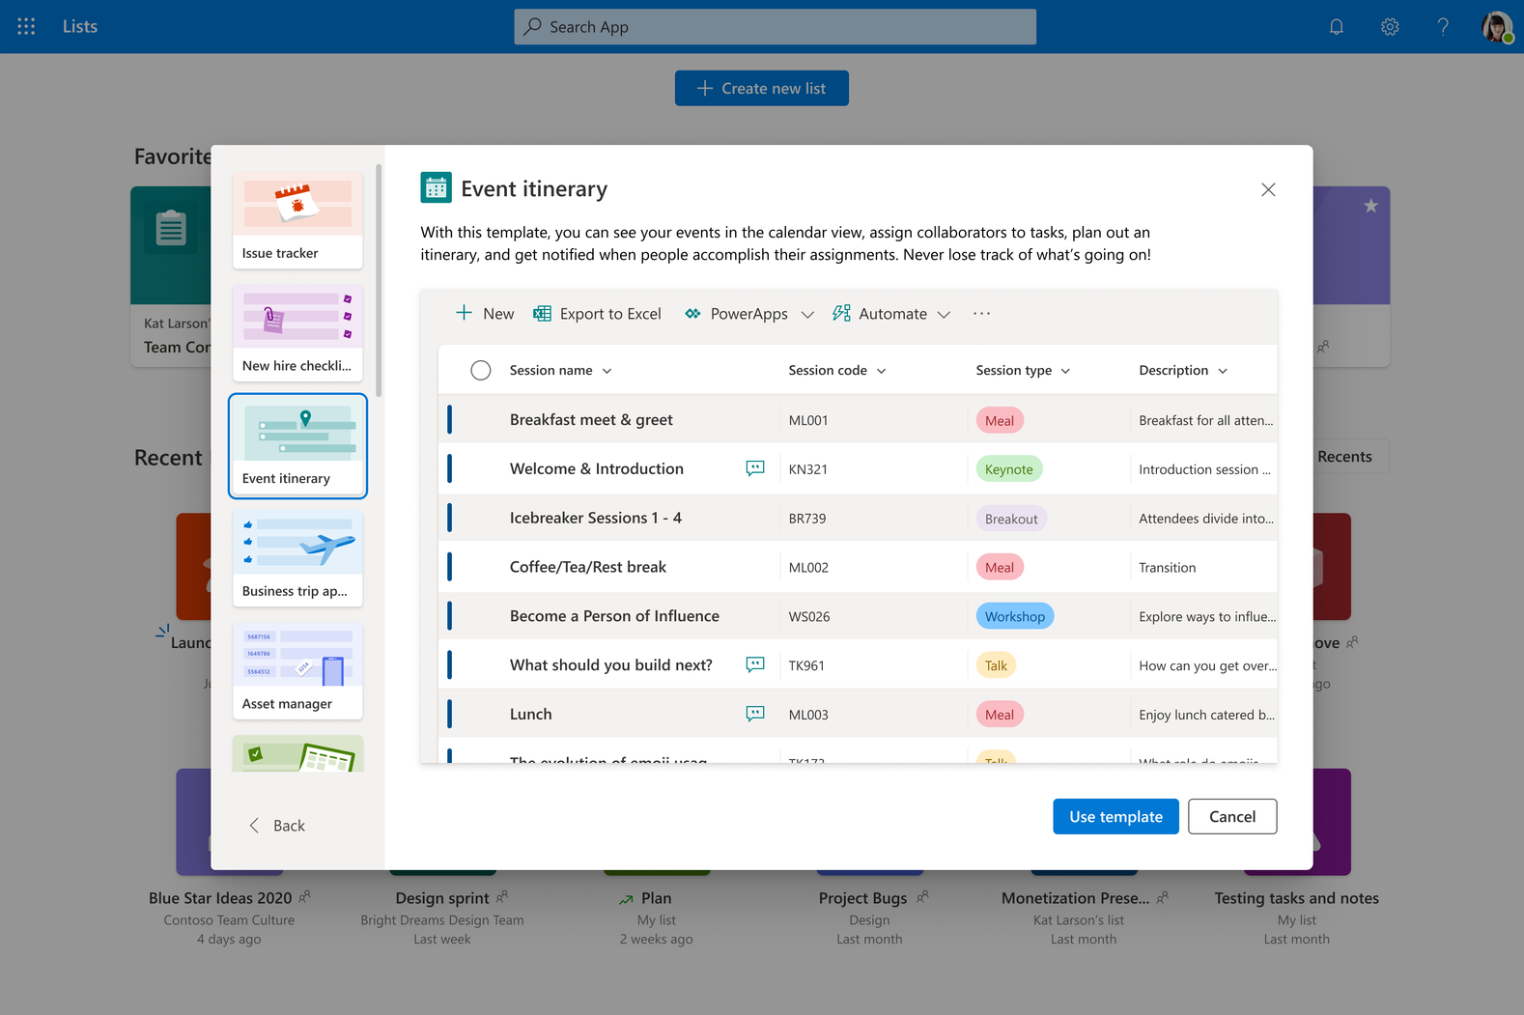
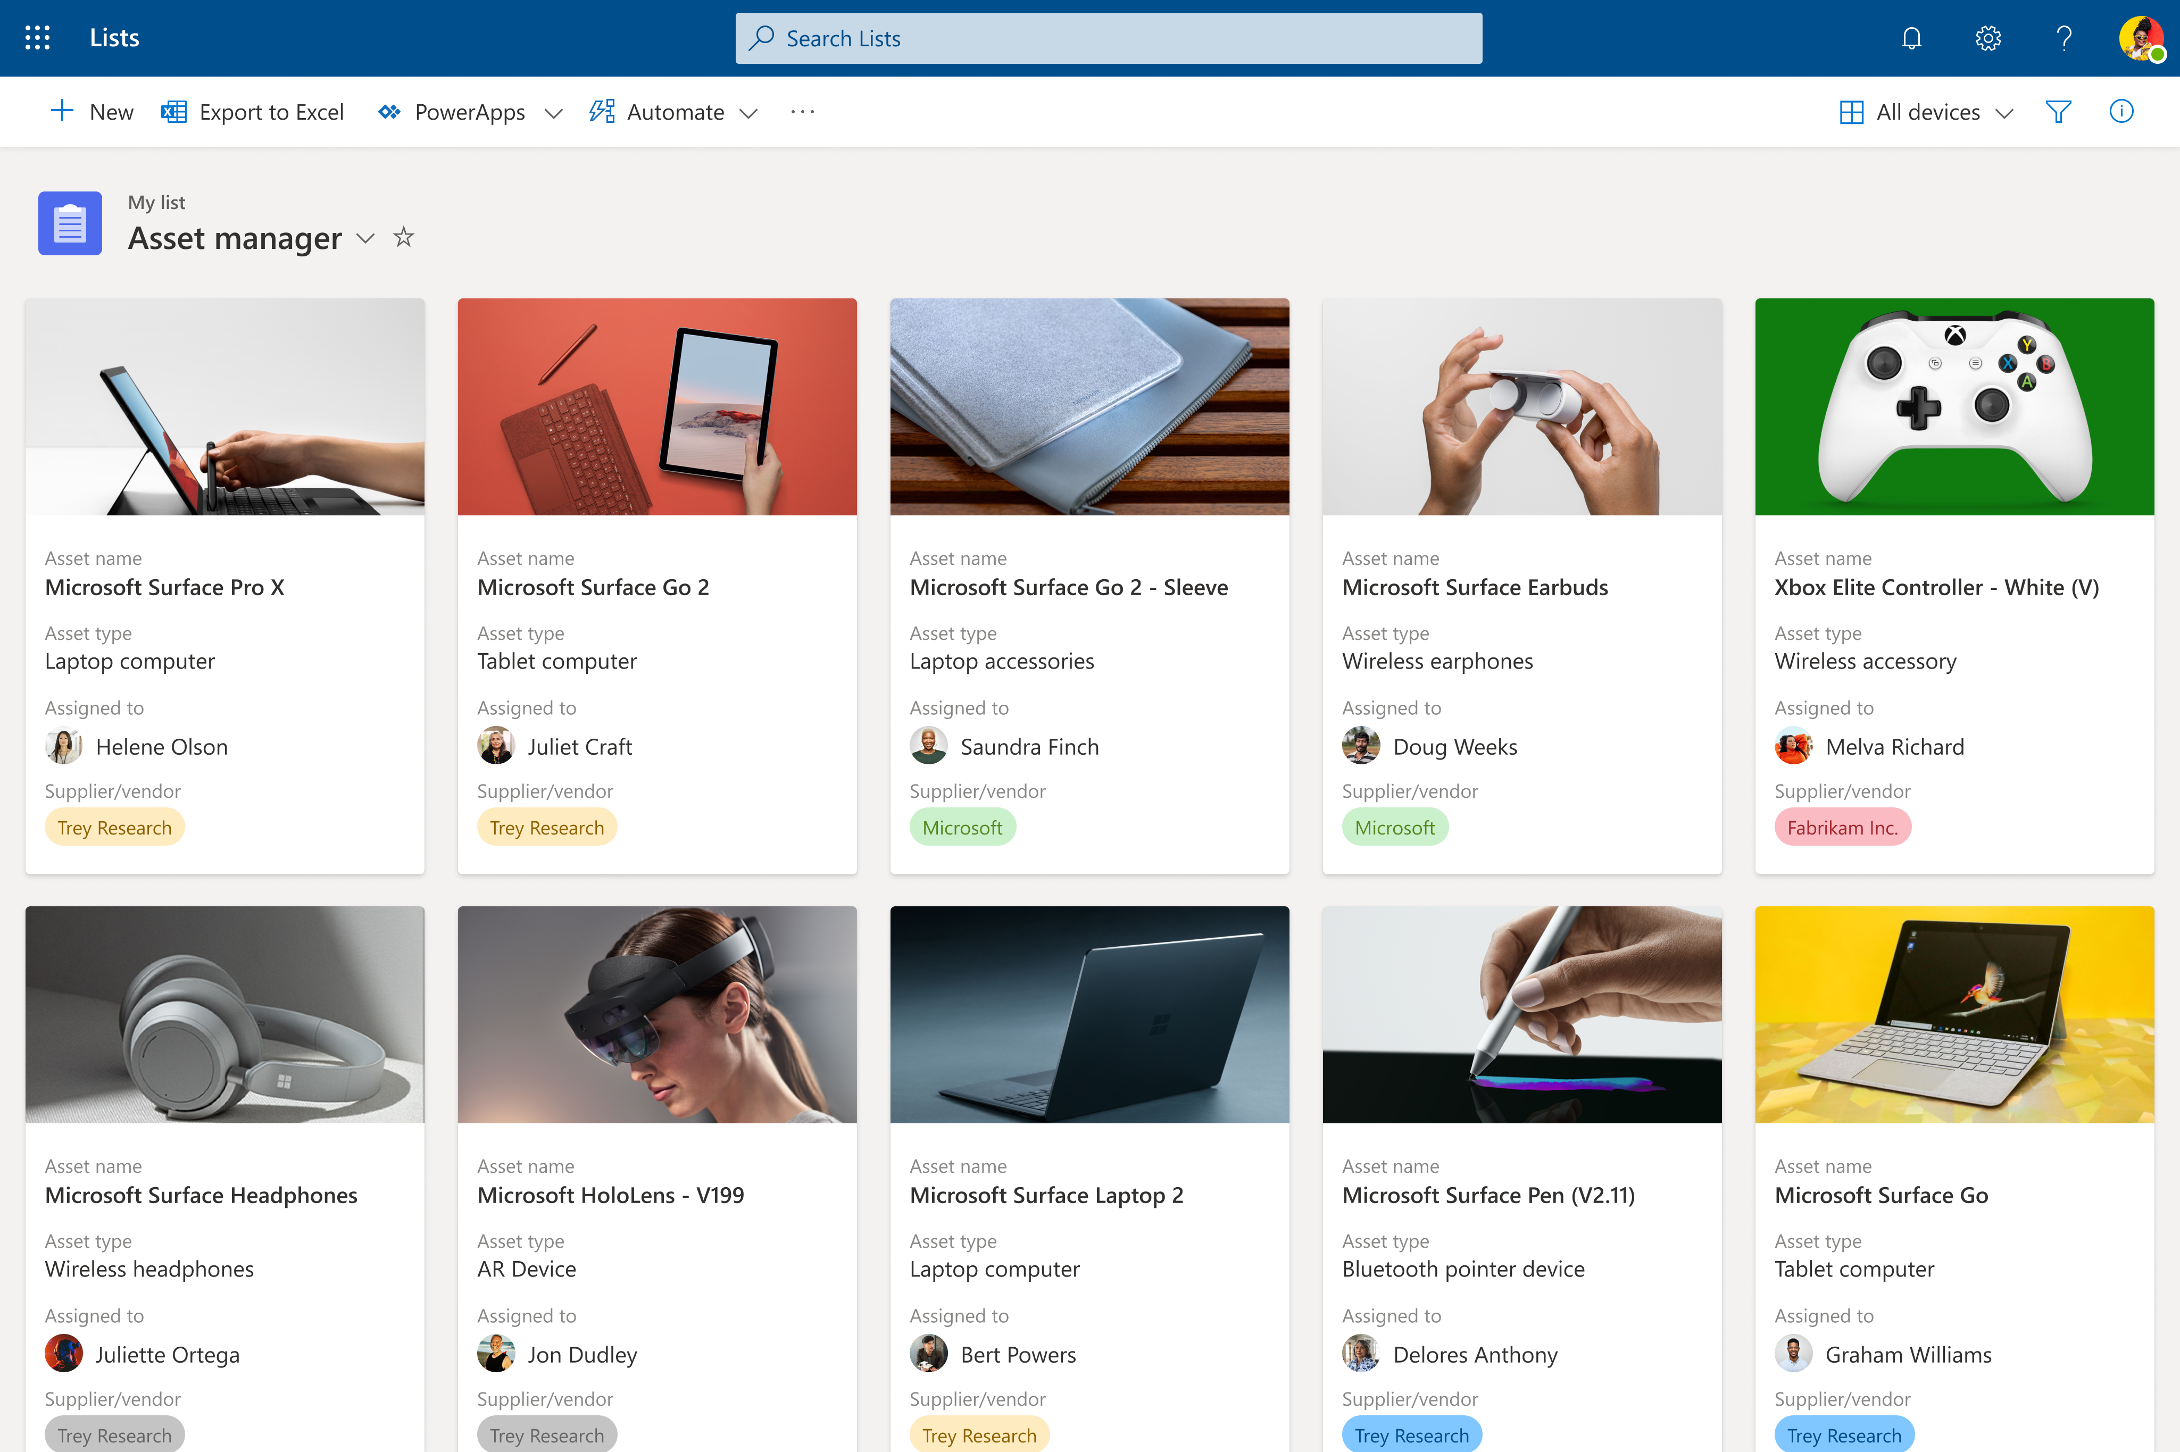
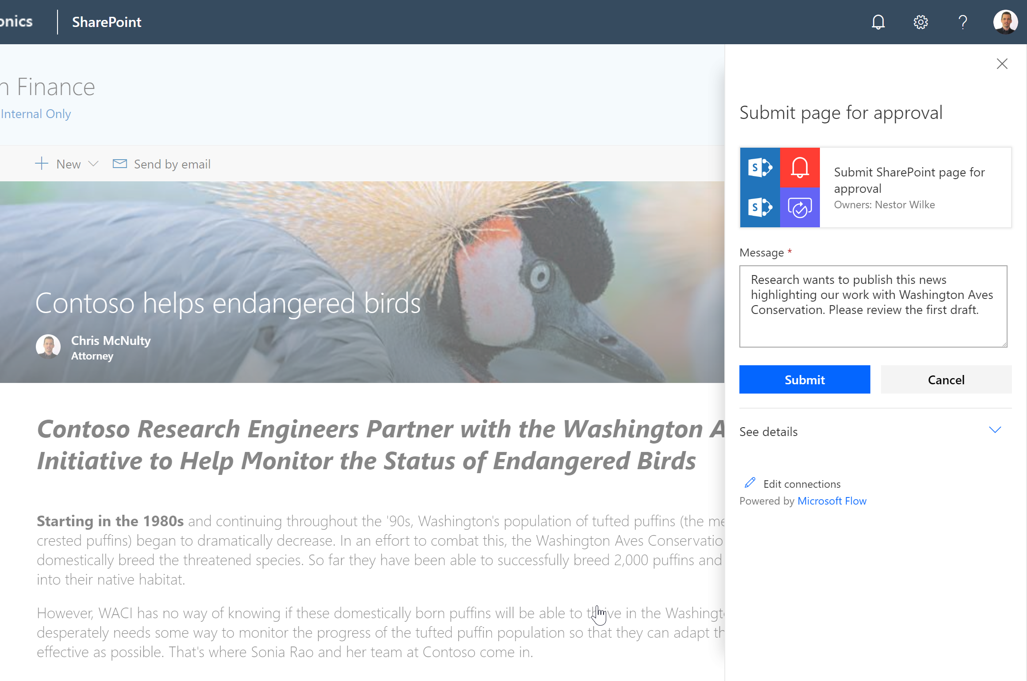
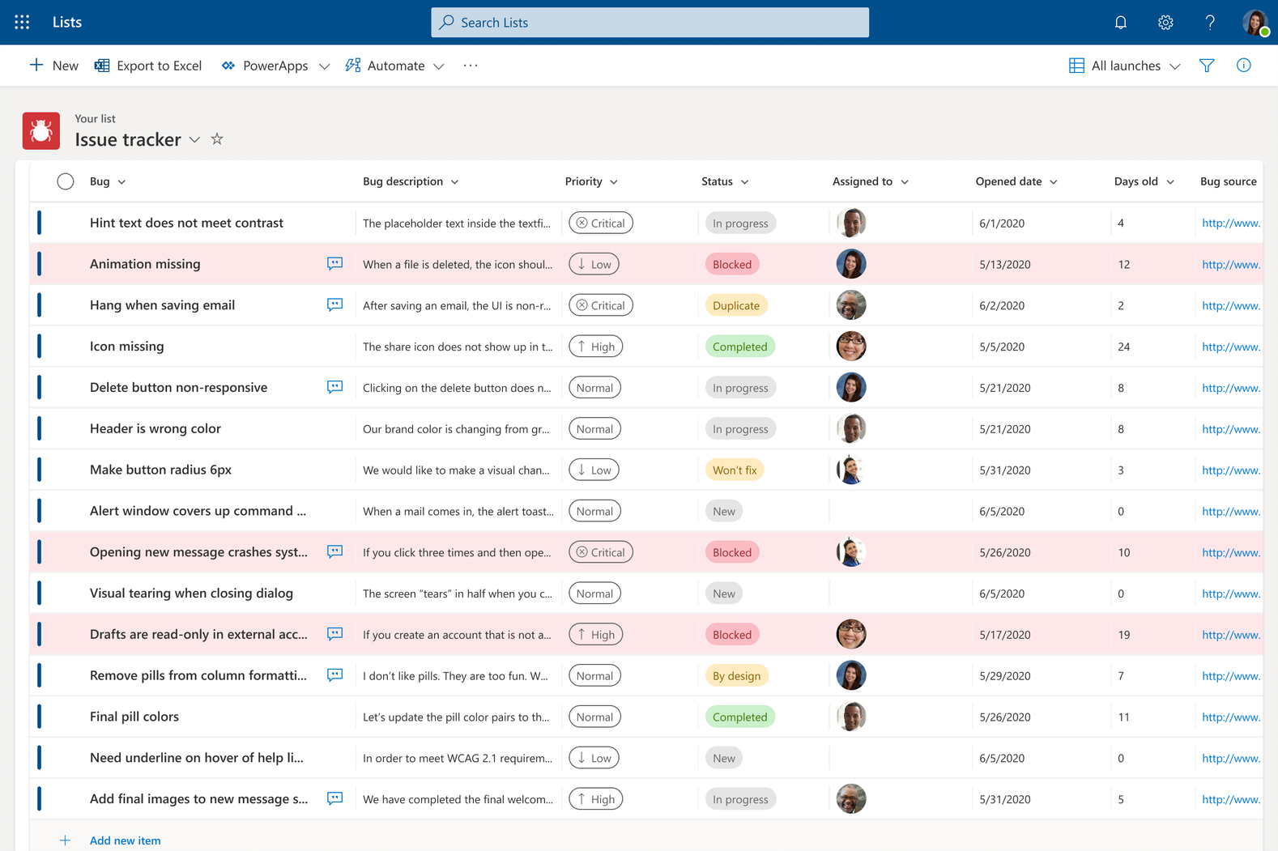
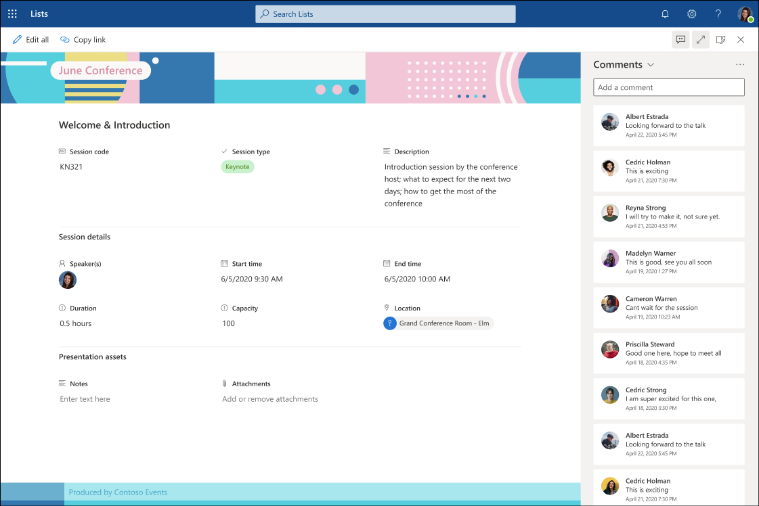
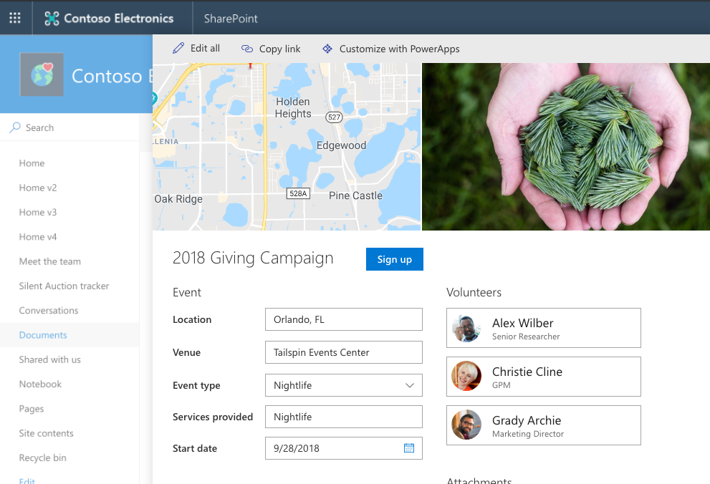
Empowering business processes via Lists
Native efficiency
Simple configuration
Integrated solutions
Collect, manage, and distribute content and data using SharePoint lists and libraries
Lists are the best way to organize the things your team cares about & must get done.
Compose analytics, user experiences, and business processes using an integrated set of services from Microsoft.
Continuum

Slide 26
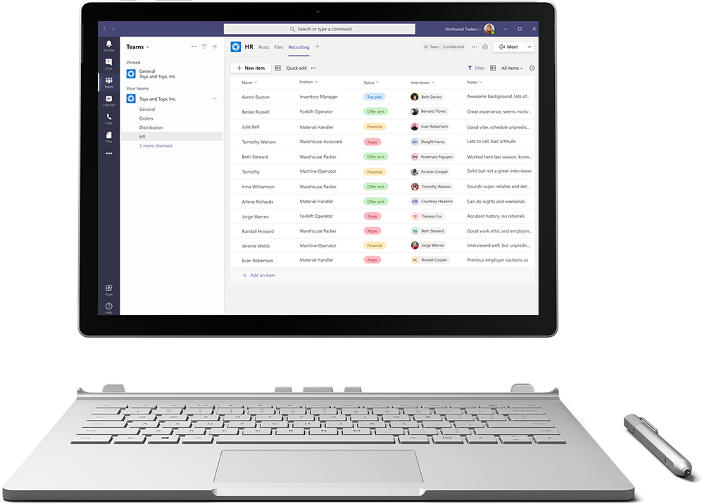
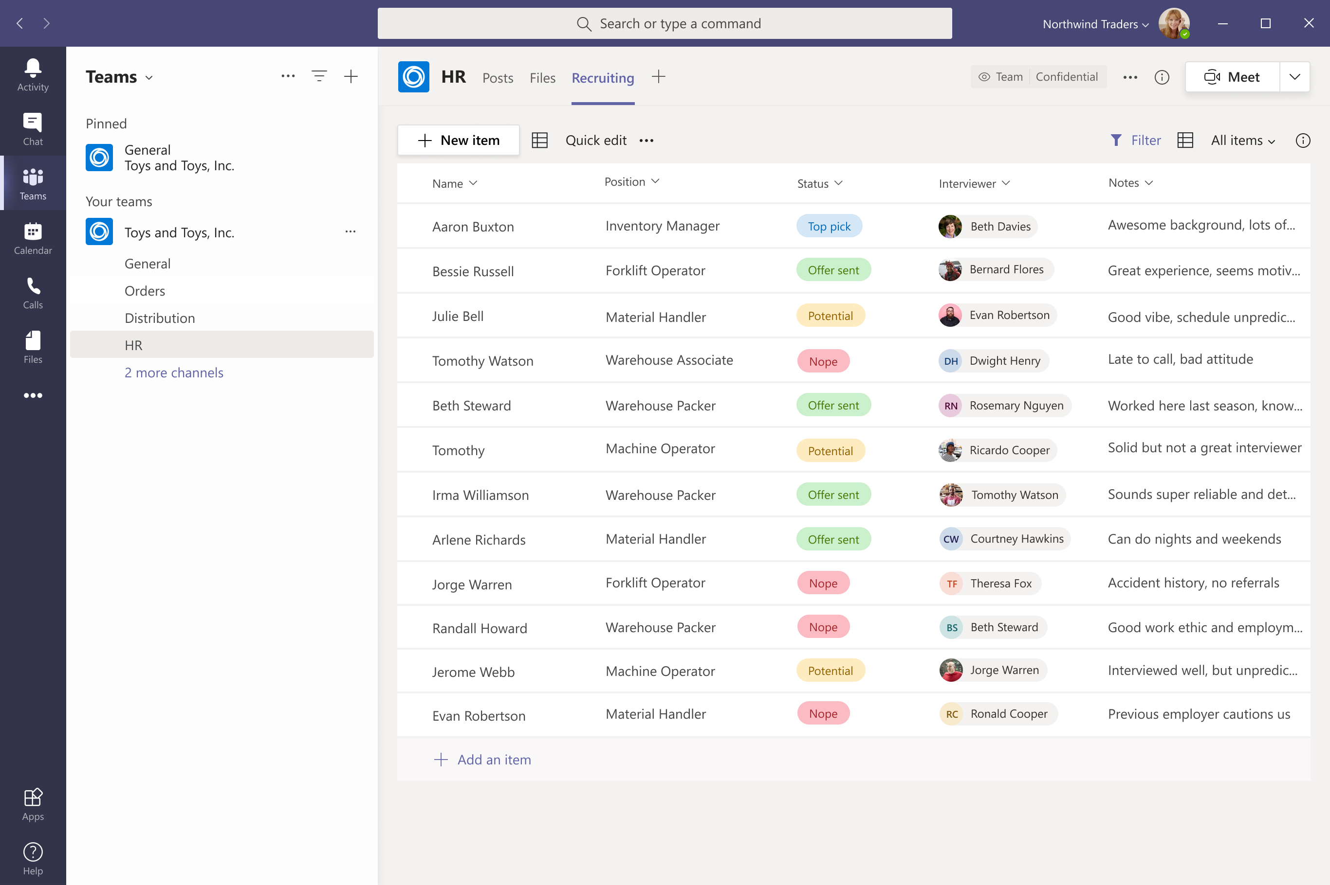

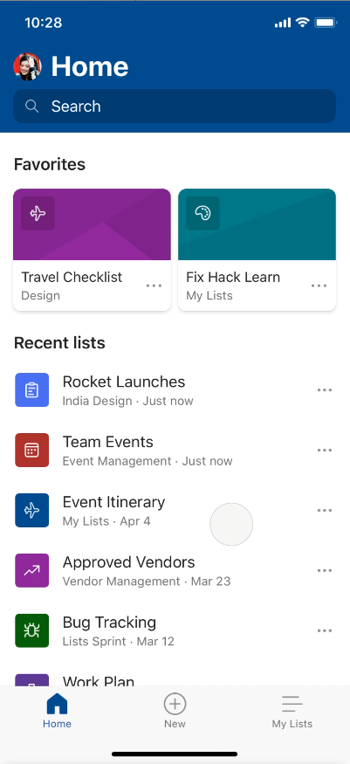
Track what matters most with Microsoft Lists
Simple
Easily create, share, and track lists with anyone, on any device
Smart
Keep everyone in sync with rules and quick edits
Flexible
Customize your lists for whatever your business needs

Slide 27


Simple configuration
Business process automation
Deep integration via API’s

Slide 28
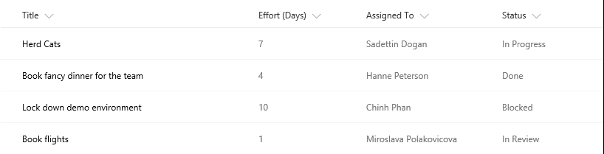
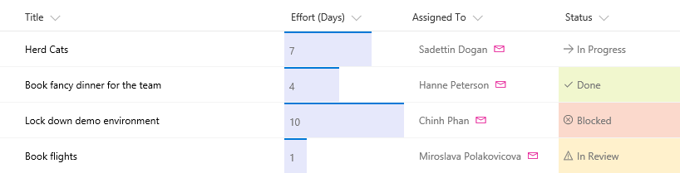
List formatting: Columns
Use JSON to control how a column is displayed
Out of the box designers available for power users
Include formatting when you provision lists
Resources
Column formatting documentation
List formatting samples
For more advanced scenarios involving custom code, checkout SPFX Field Customizers

Slide 29
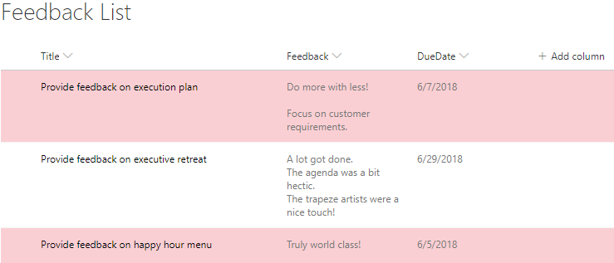
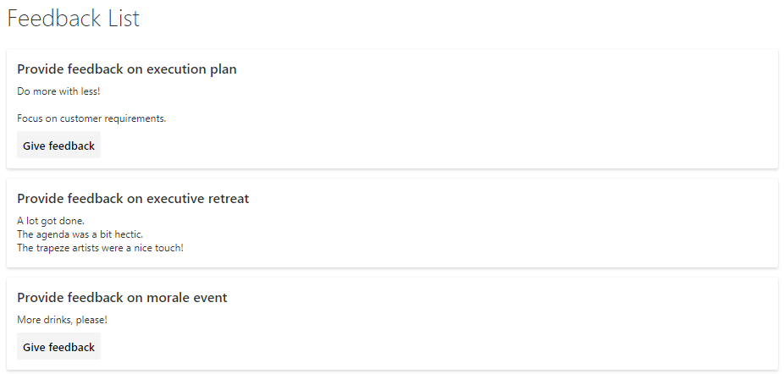
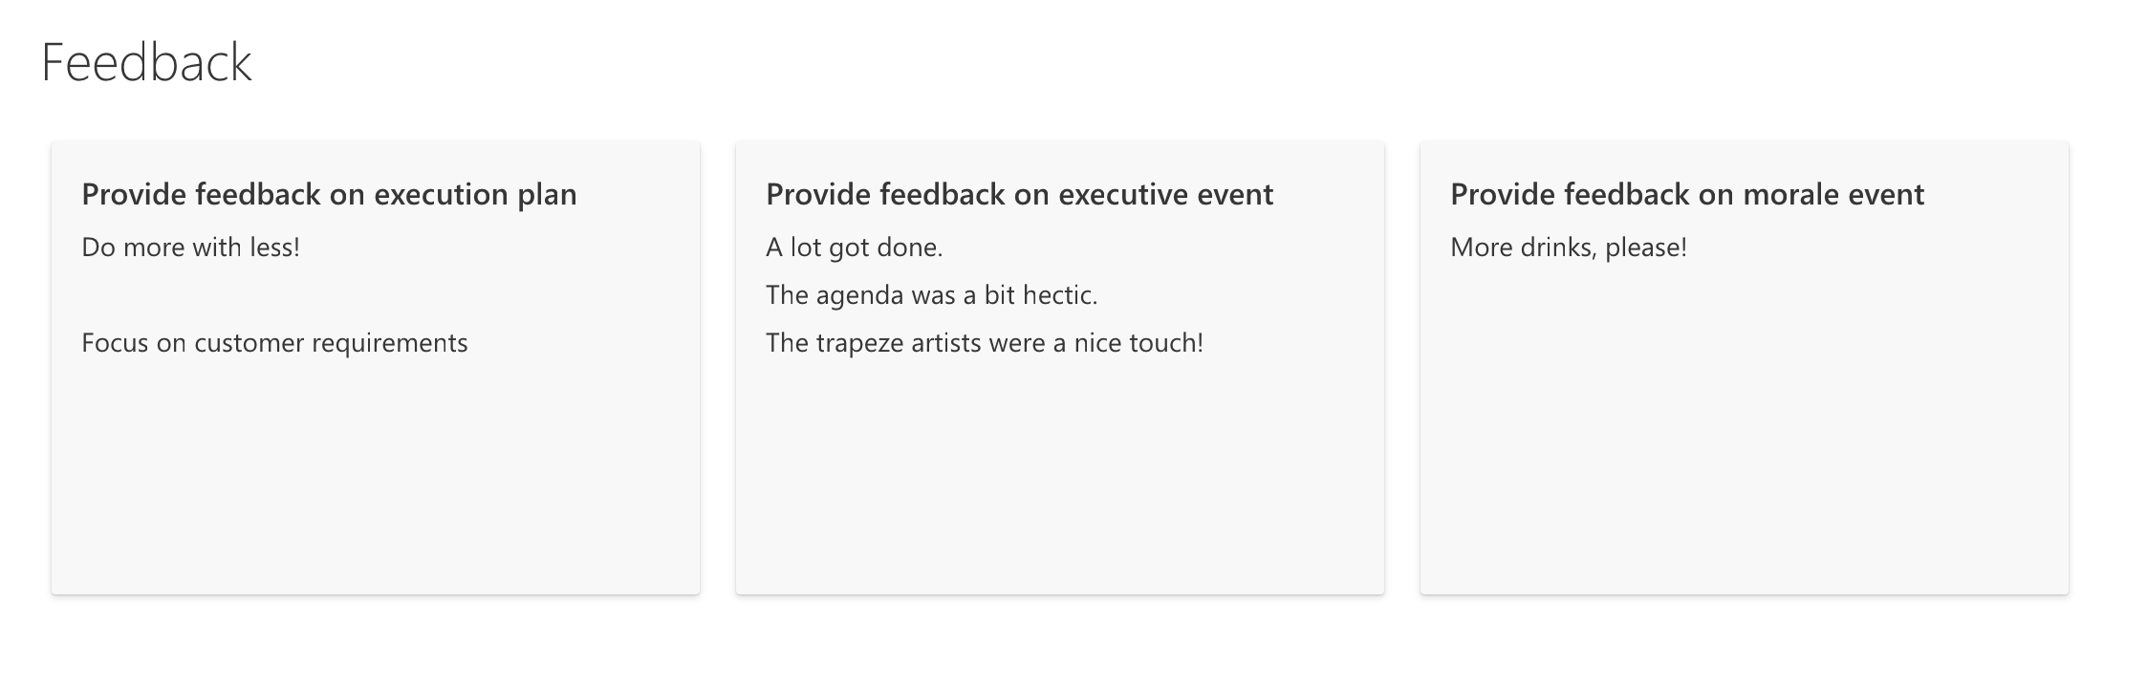
List formatting: Views
Use JSON to control how a view is presented
Out of the box designers available for power users
Include formatting when you provision lists
Resources
List formatting documentation
List formatting samples

Slide 30
List form configuration
Configure how a list edit/view form is shown
Show, hide and reorder columns
Conditional Show/Hide columns
Use JSON to format form header/footer and create sections in the form
Resources
List form documentation
Configure the List form using formatting
List formatting samples

Slide 31
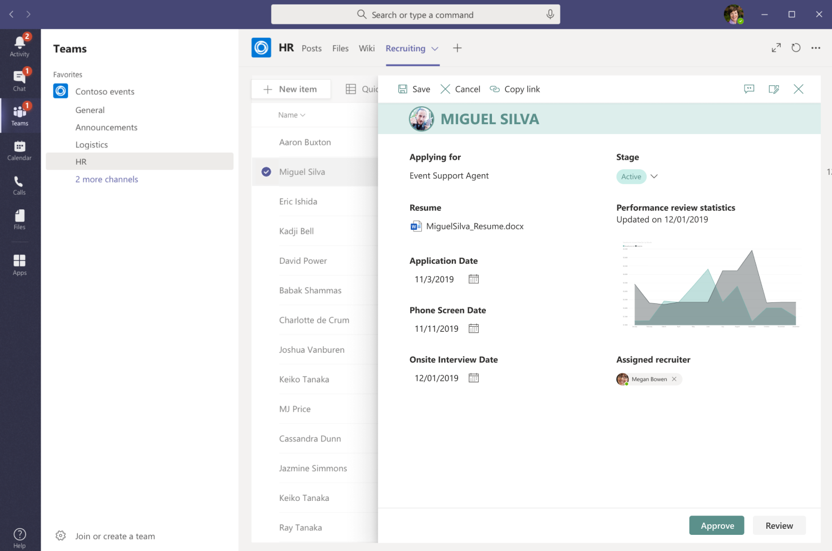
Power Apps integration
Customize your lists and library forms using Power Apps platform.
Resources
Power Apps documentation
Microsoft Lists Resource Center
Power Platform samples

Slide 32


Simple configuration
Business process automation
Deep integration via API’s

Slide 33
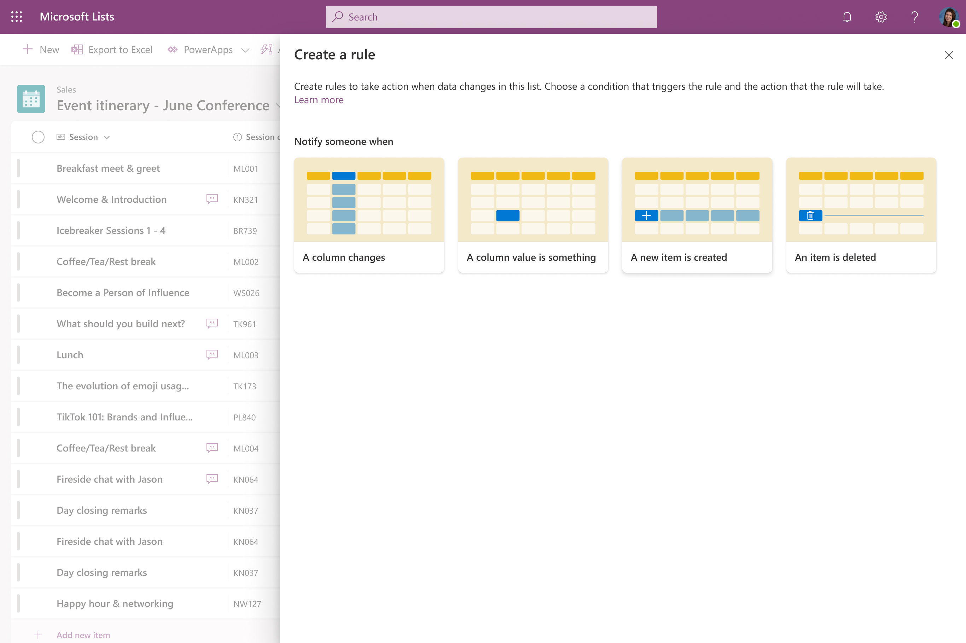
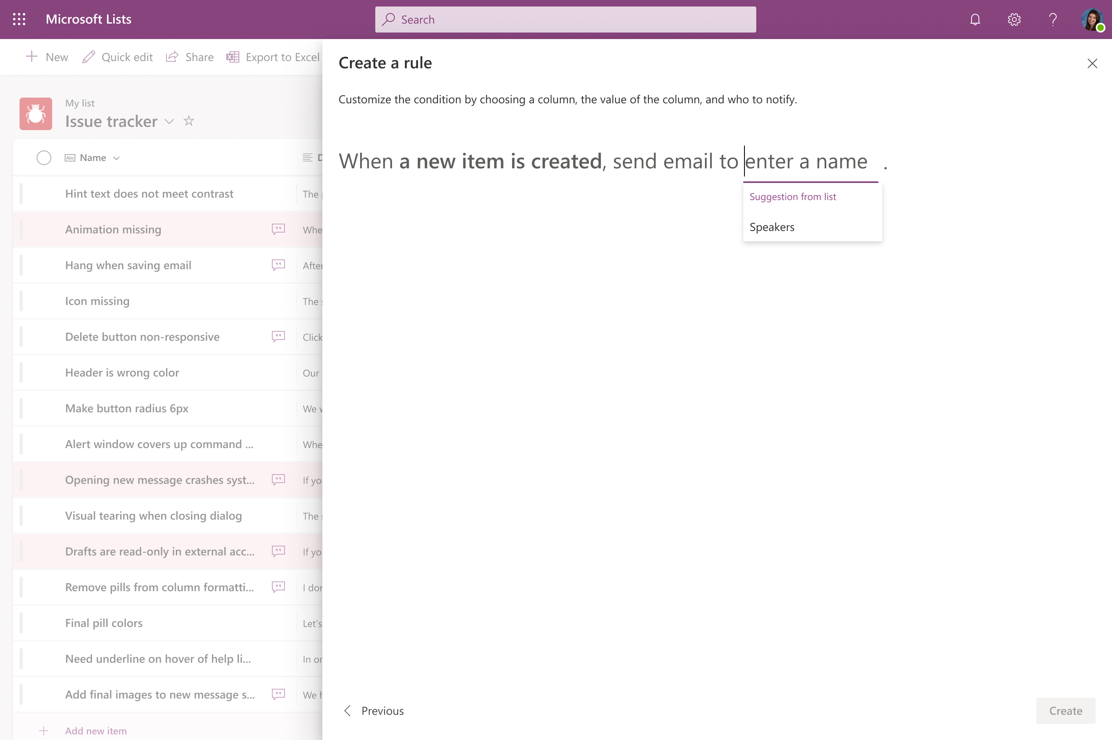
List rules
Trigger a notification based upon rules. Notify someone when:
A column changes
A column value changes
A new item is created
An item is deleted
Resources
Microsoft Lists Resource Center
Create a rule to automate a list

Slide 34
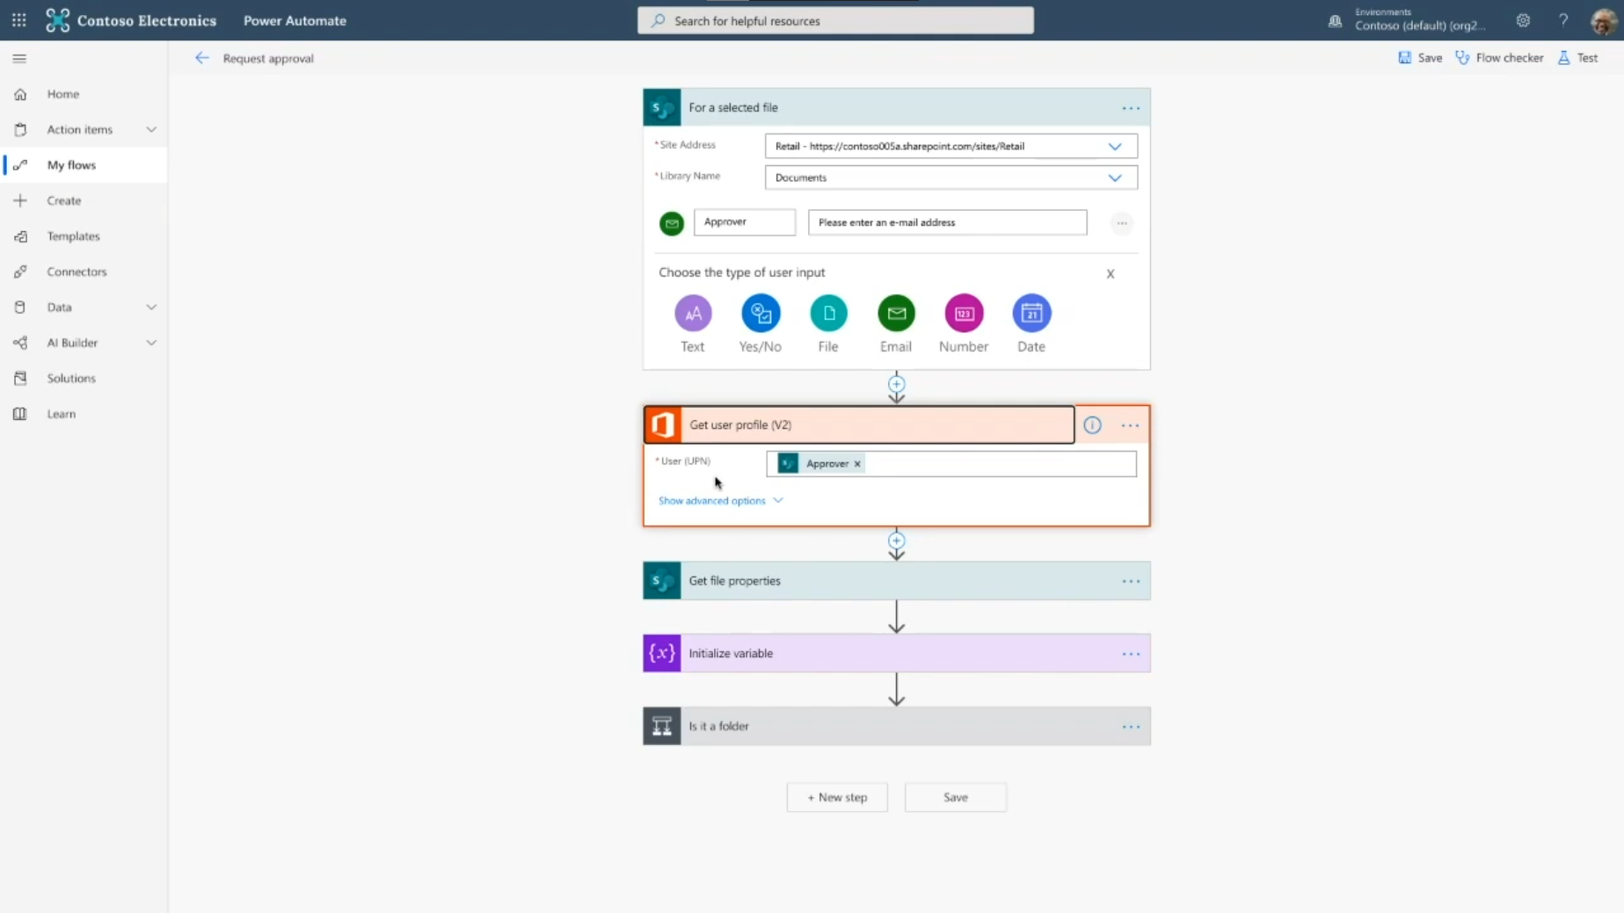
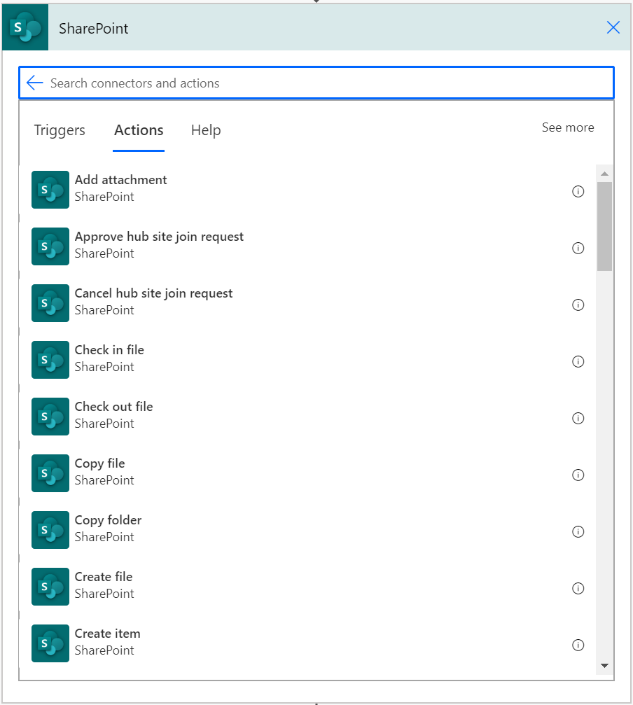
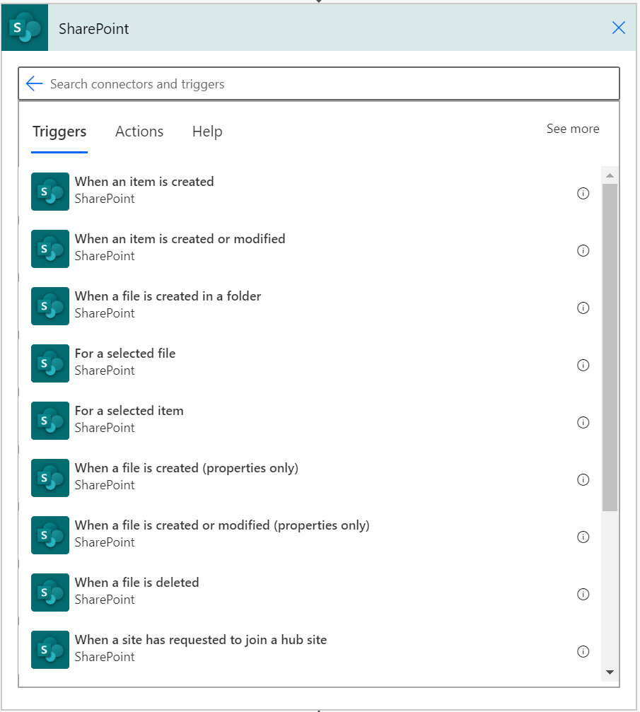
Power Automate integration
Enable business processes on top of lists & libraries via the SharePoint Connector
Reminders on date columns
Sign-off, content and page approvals
Your custom business process
Resources
Microsoft Lists Resource Center
SharePoint Power Automate Connector
Power Platform samples

Slide 35
Simple configuration
Business process automation
Deep integration via API’s

Slide 36
Basic Microsoft Graph elements
Sites – Contains lists, drives, and subsites
/v1.0/sites/{site-id}
List – Contains items, column definitions and content types
ListItem – The item data for the item in a list
/v1.0/sites/{site-id}lists/{list-id}/items/{item-id}

Slide 37
SharePoint Framework
Using SharePoint Framework (SPFx) to extend and enrich the SharePoint and Microsoft Teams user experience

Slide 38
What is SharePoint Framework?
Microsoft Graph
Extension header
Application pages
Custom tabs
Web parts
Personal apps
Page visuals Office UI Fabric
Task modules
Meeting apps
Extension footer
“An application framework used to build and extend modern experiences in SharePoint and in Microsoft Teams”
SPFx was publicly announced May 4th, 2016

Slide 39
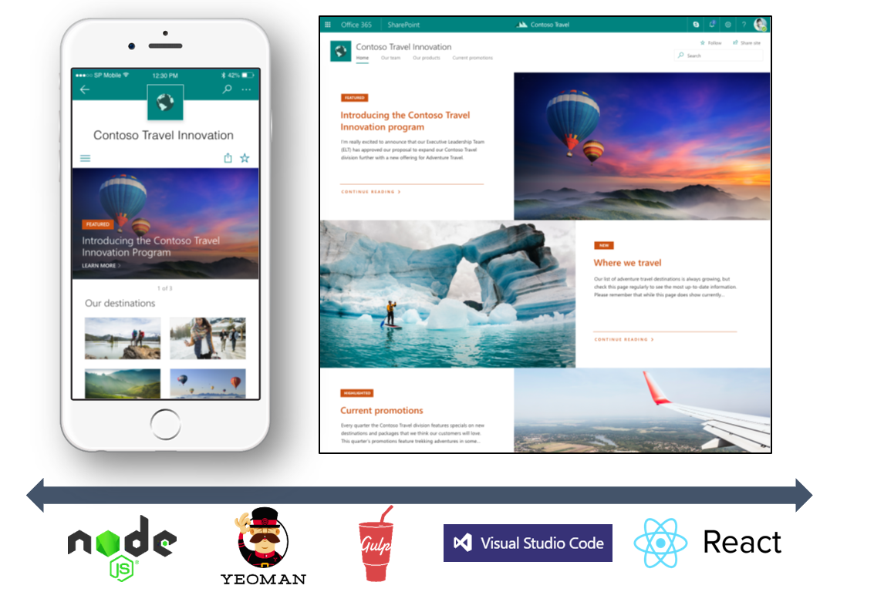
SharePoint Framework (SPFx)
Modern client-side development
Lightweight web and mobile
Powers our own experiences
Backward compatible
Supports open-source tools and JavaScript web frameworks
Resources
SharePoint Framework Tutorials
SharePoint Framework
Microsoft Graph
LOB Systems and Cloud Services

Slide 40
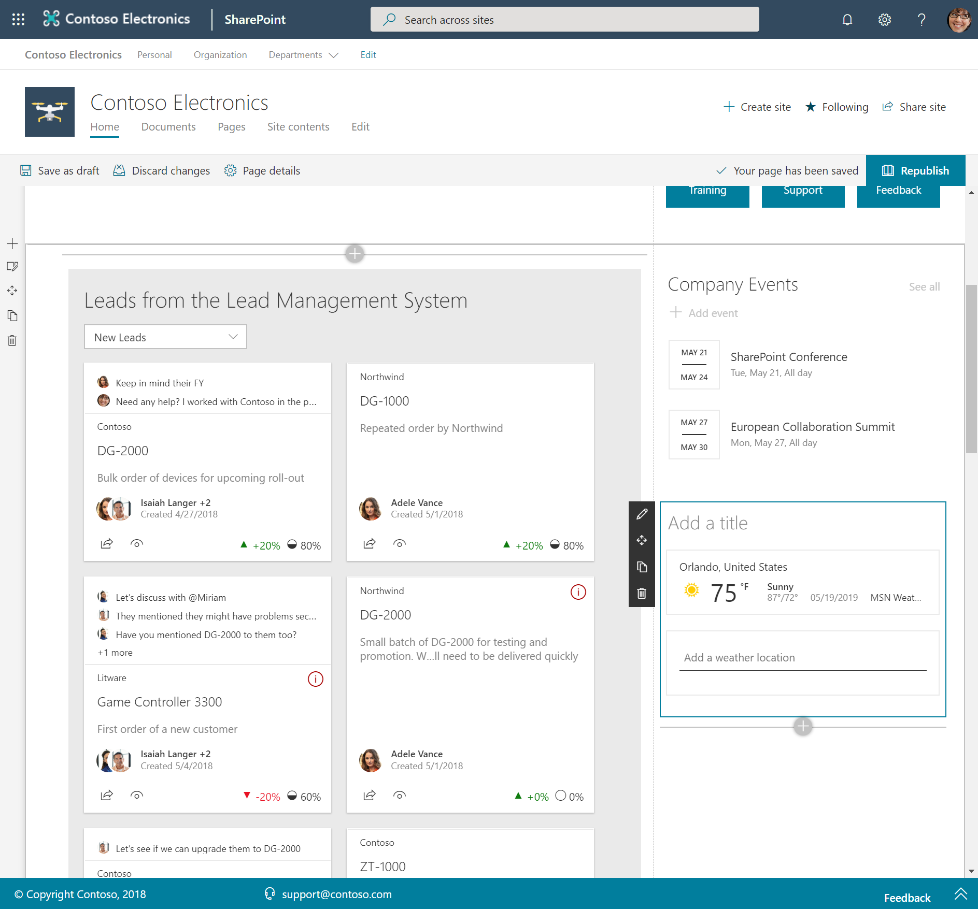
Web parts
Controls that appear inside a SharePoint page and execute client-side in the browser
Resources
SharePoint Framework documentation
Develop web parts with the SharePoint Framework
SharePoint Framework (SPFx) Web Part Samples
Microsoft Teams development samples (includes SPFx web parts)

Slide 41
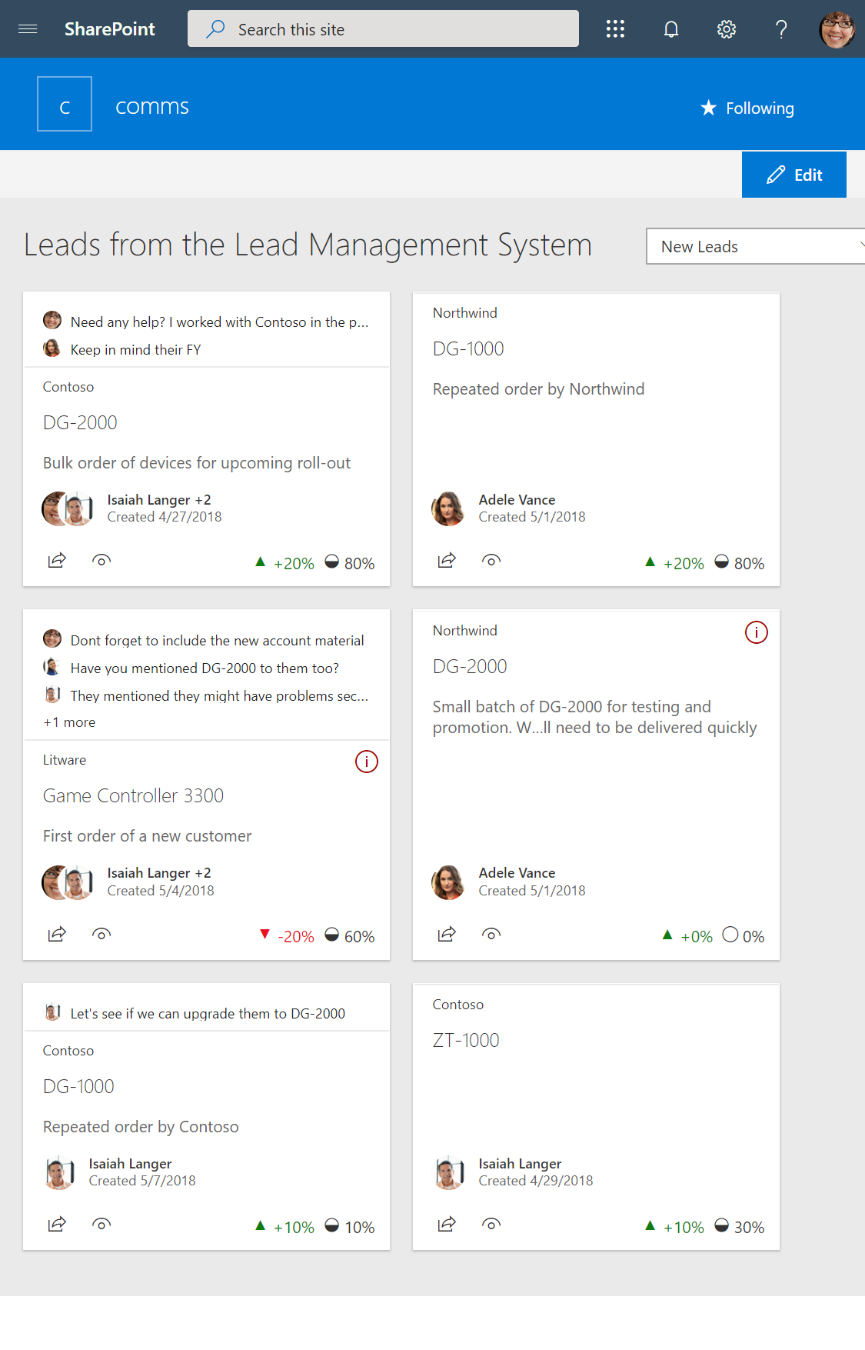
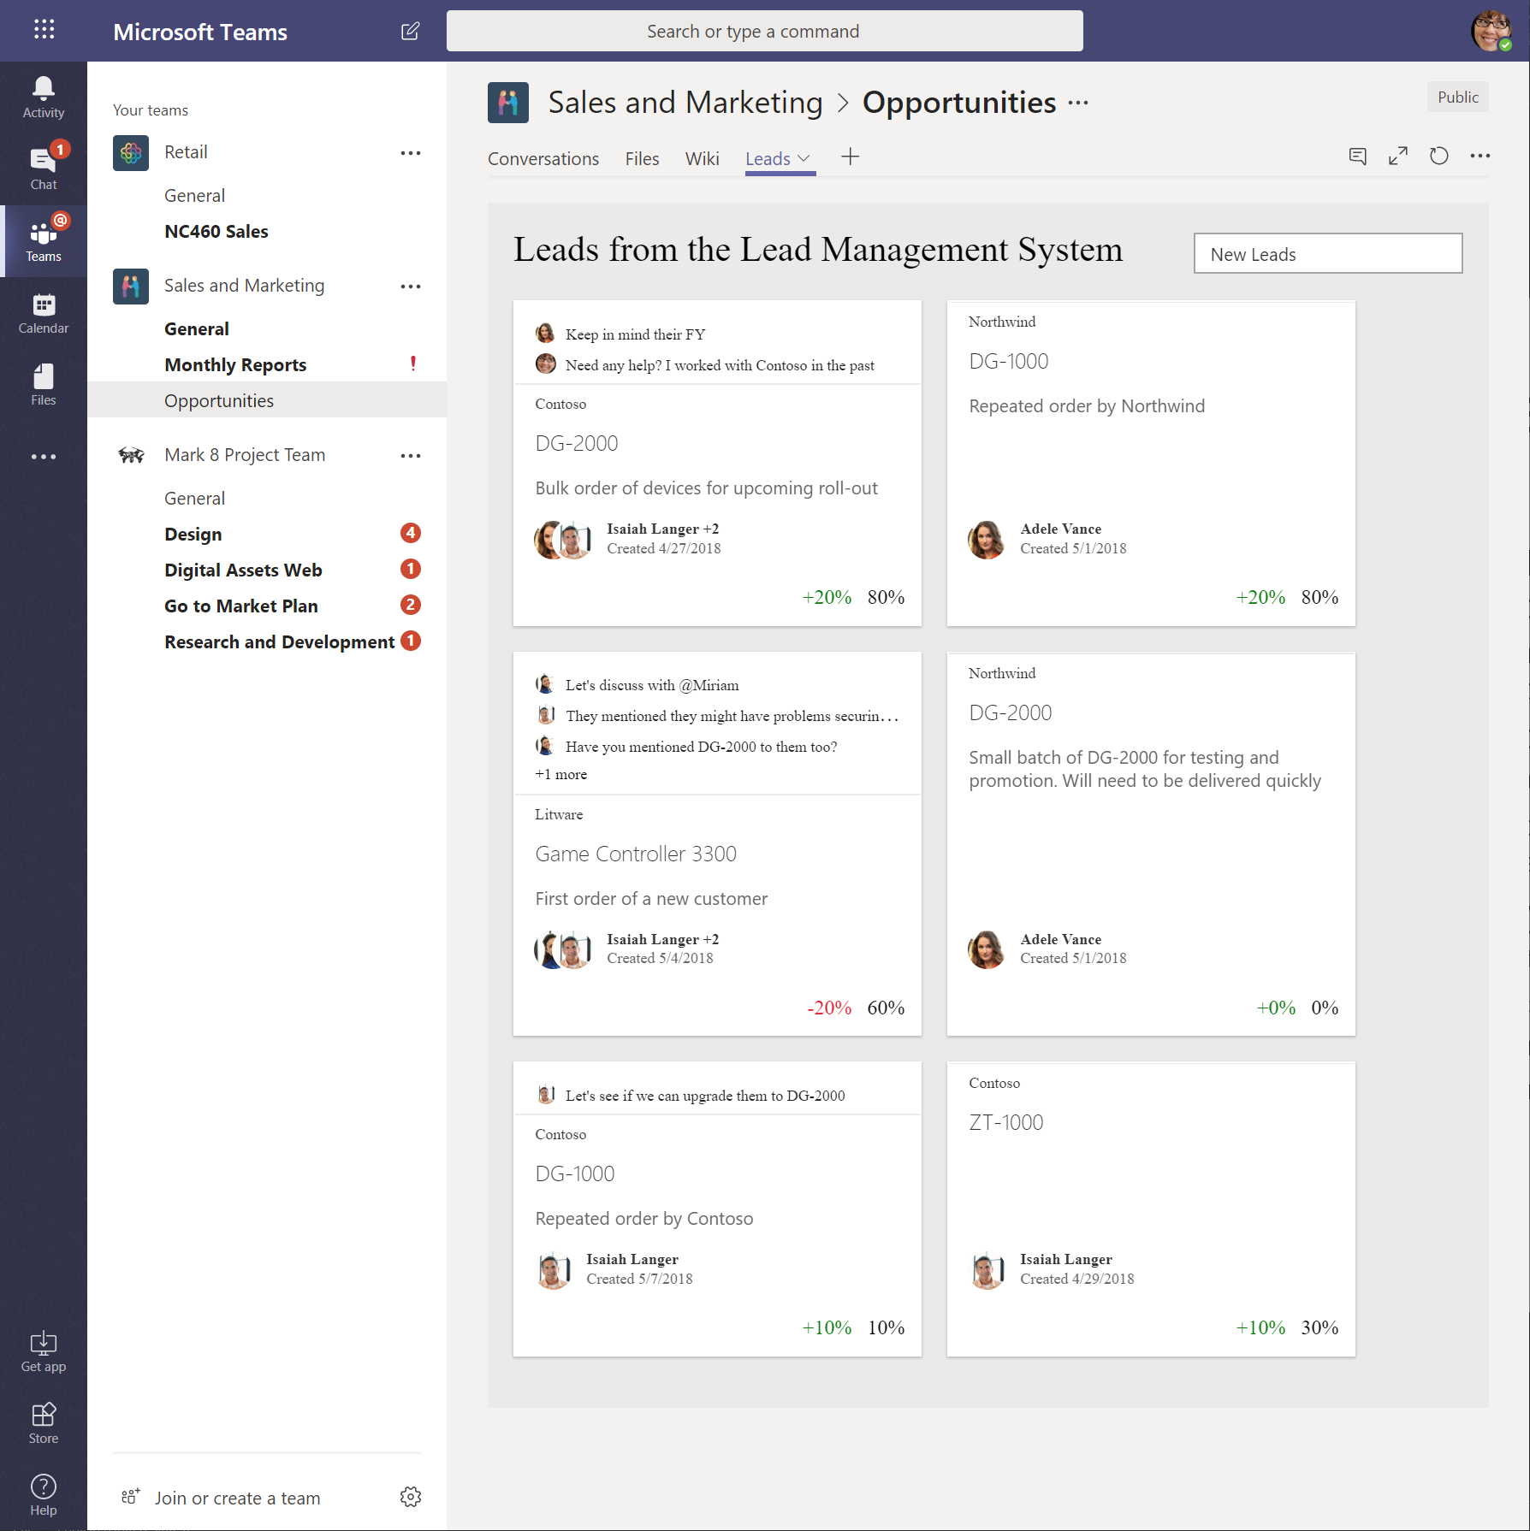
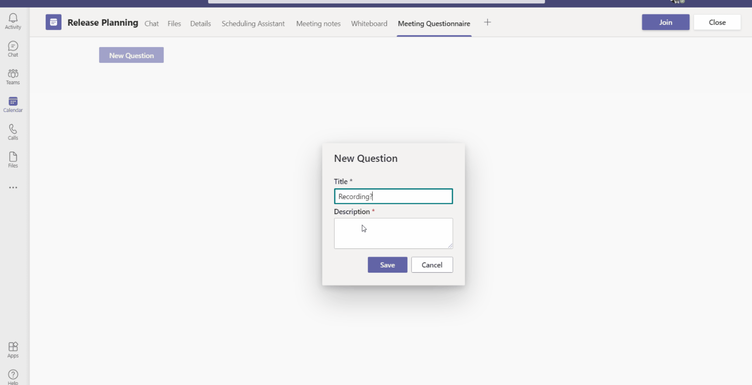
Use web parts across services
Web parts
App pages
Teams tabs
Personal Teams apps
Teams meeting apps

Slide 42
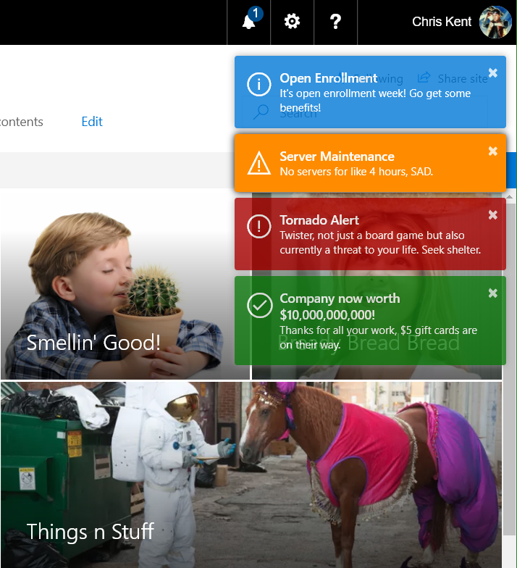
Application customizers
Adds scripts to the page, and accesses well-known HTML element placeholders and extends them with custom renderings
Resources
SharePoint Framework documentation
Extend the SharePoint user interface with SPFX extensions
SharePoint Framework (SPFx) Extensions Samples

Slide 43
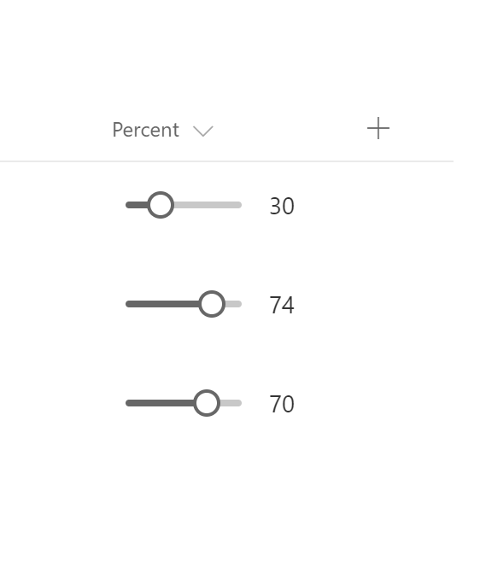
Field customizers
Provides modified views to data for fields within a list
Resources
SharePoint Framework documentation
Extend the SharePoint user interface with SPFX extensions
SharePoint Framework (SPFx) Extensions Samples

Slide 44
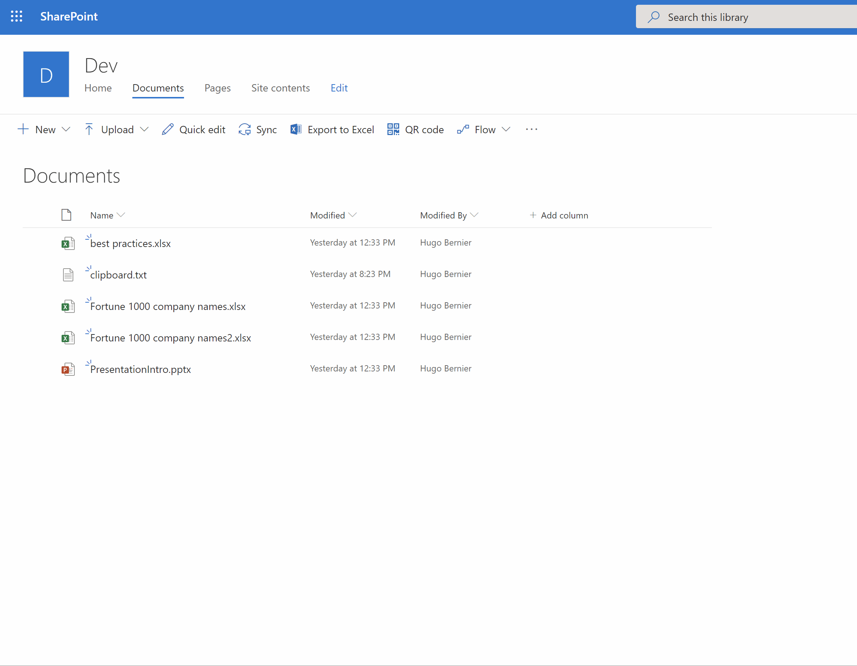
Command sets
Extends the SharePoint command surfaces to add new actions, and provides client-side code that you can use to implement behaviors
Resources
SharePoint Framework documentation
Extend the SharePoint user interface with SPFX extensions
SharePoint Framework (SPFx) Extensions Samples

Slide 45
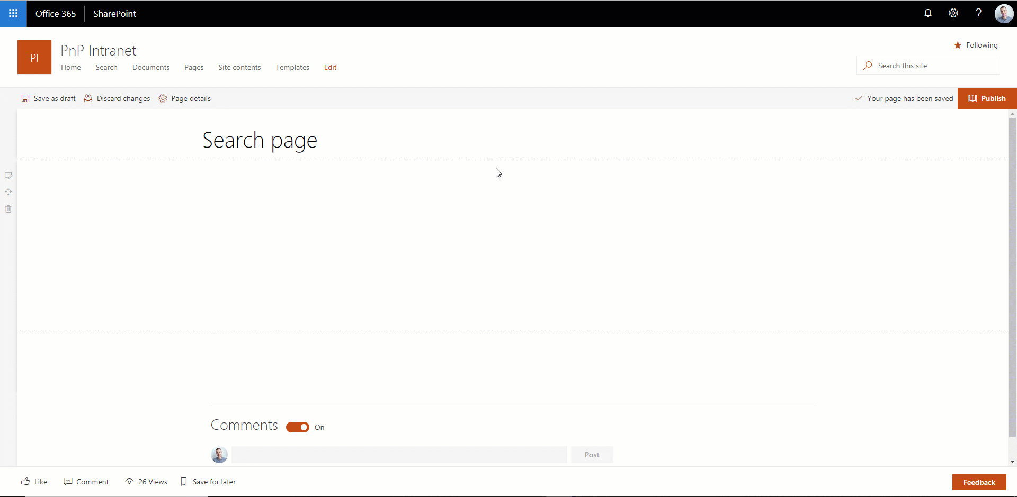
Search Query extension
Allows you to manipulate the user's search query before it is sent to SharePoint
Resources
SharePoint Framework documentation
PnP Modern Search
Getting started with Search Query extensions

Slide 46
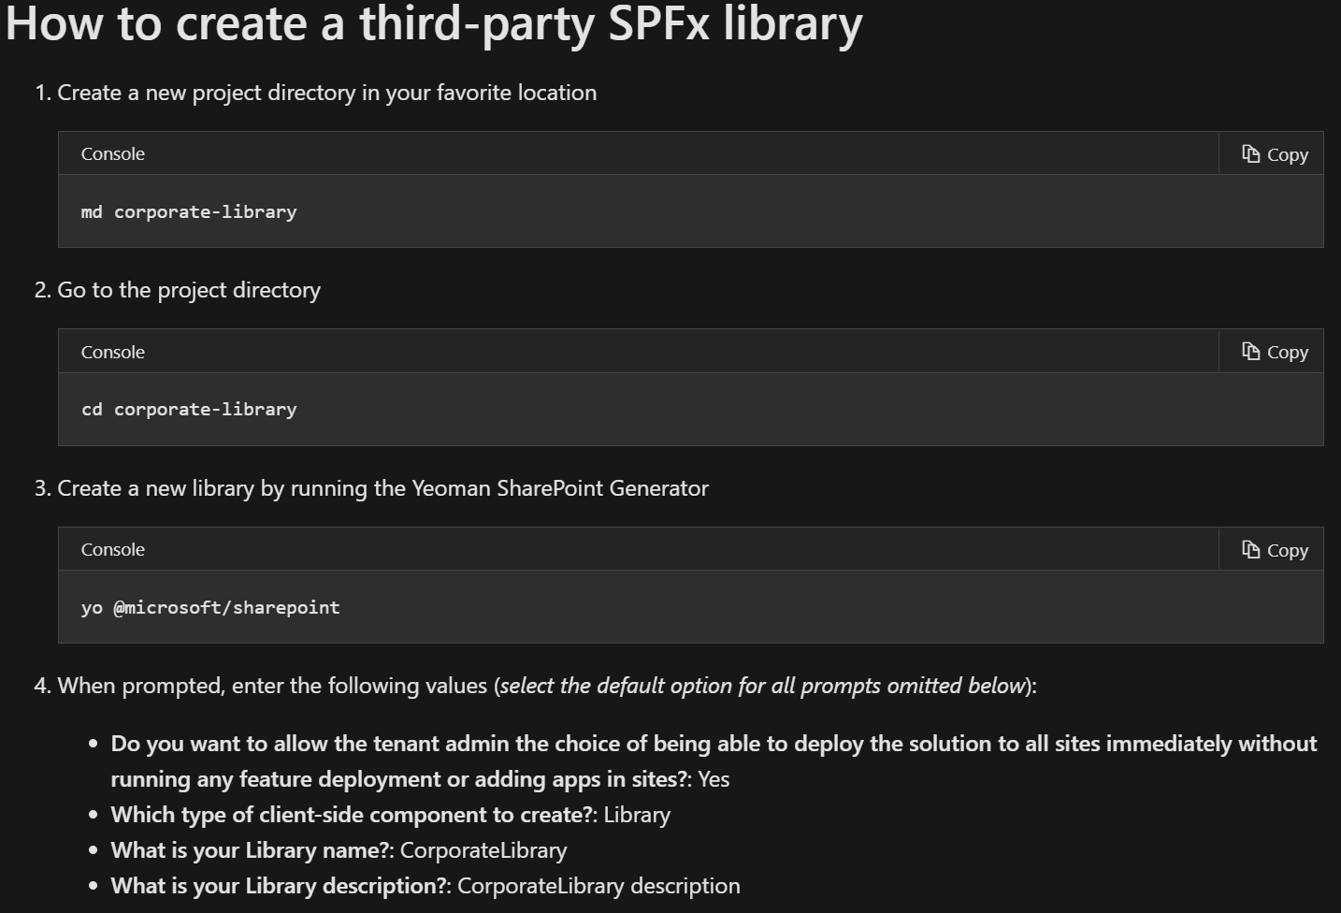
Library components
The library component type in the SharePoint Framework (SPFx) enables you to have independently versioned and deployed code served automatically for your SharePoint Framework components
Resources
SharePoint Framework documentation
SharePoint Framework Library component overview
SharePoint Framework Library samples

Slide 47
Deployment and configuration
Take control over how users create sites, make your apps available to the SharePoint users

Slide 48








App deployment options
AppSource/SharePoint Store (public)
My public app
Tenant App Catalog (private)
My public app
My private app 1
My private app 2
Site A
Site A
Site A
Site Apps
Site Apps
Site App Catalog
Site Apps
My public app
My private app 1
My private app 1
My private app 1
My private app 2
Site private app
Site private app

Slide 49
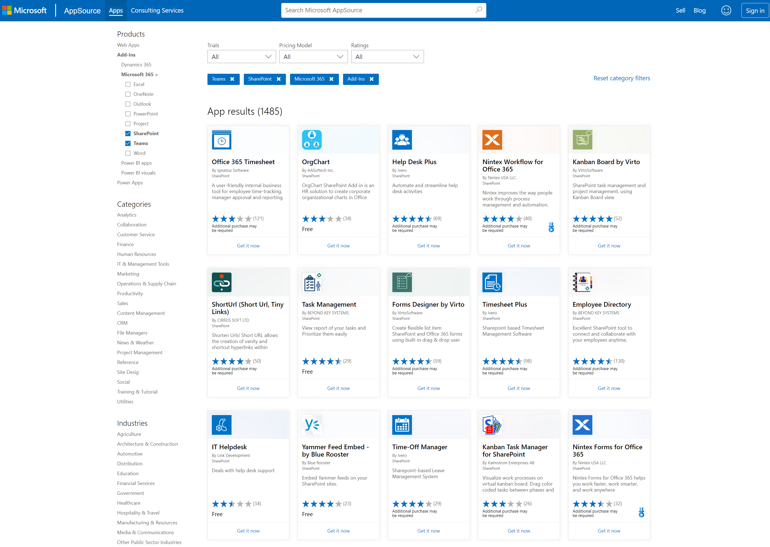
App source
Public store for SharePoint, Teams and Office apps
Resources
App source documentation
Microsoft App Source

Slide 50


Site designs and site scripts
Automate SharePoint provisioning to new or existing SharePoint
Create SharePoint artefacts such as lists, libraries, content types
Update navigation and apply branding
Configure security
Deploy apps
Trigger Power Automate for custom coded provisioning tasks
Resources
Site design and site scripts documentation

Slide 51
Open source software
There’s a very vibrant community of Microsoft developers building open source for SharePoint, OneDrive and Microsoft Graph

Slide 52








Open-source software
Microsoft 365 developer videos
Microsoft 365 & SharePoint community (PnP) videos
Open source
Sample galleries
Initiatives
github.com/sharepoint
github.com/pnp
github.com/officedev
github.com/microsoftgraph
aka.ms/spfx-webparts
aka.ms/spfx-extensions
aka.ms/list-formatting
aka.ms/teams-samples
aka.ms/m365pnp
aka.ms/M365DevYouTube
aka.ms/m365pnp-videos
@Microsoft365Dev | @m365pnp

Slide 53
Thank you

